Slide 1
Tutorial Talk: Certified Deletion
James Bartusek
UC Berkeley

Slide 2
Outline
Basic scenario and applications
Recipe for constructions
Security
Certifiable deletion of programs

Slide 3
Outline
Basic scenario and applications
Recipe for constructions
Security
Certifiable deletion of programs

Slide 4


Certified Deletion: Cloud Storage
D

Slide 5




Certified Deletion: Cloud Storage
|
$$⟩$$
D
|
$$⟩$$
D
Assumption: Malicious server cannot recover D from the encoding in polynomial time

Slide 6
Certified Deletion: Cloud Storage
|
$$⟩$$
D
|
$$⟩$$
D
Assumption: Malicious server cannot recover D from the encoding in polynomial time

Slide 7
Certified Deletion: Cloud Storage
|
$$⟩$$
D
|
$$⟩$$
“Please delete my data”
D
Assumption: Malicious server cannot recover D from the encoding in polynomial time

Slide 8



Certified Deletion: Cloud Storage
|
$$⟩$$
D
|
$$⟩$$
“Please delete my data”
Assumption: Malicious server cannot recover D from the encoding in polynomial time

Slide 9
Certified Deletion: Cloud Storage
[Broadbent, Islam 20]
[Hiroka, Morimae, Nishimaki, Yamakawa 21]
Classically: [Garg, Goldwasser, Vasudevan 20]
|
$$⟩$$
D
|
$$⟩$$
“Please delete my data”
Assumption: Malicious server cannot recover D from the encoding in polynomial time
Goal #1: After deletion, the server won’t be able to recover D even given
Goal #2: After deletion, the server won’t be able to recover D even given unbounded time
Requirements: encryption + unclonability

Slide 10
Certified Deletion: Cloud Storage
[Broadbent, Islam 20]
[Hiroka, Morimae, Nishimaki, Yamakawa 21]
Classically: [Garg, Goldwasser, Vasudevan 20]
|
$$⟩$$
D
|
$$⟩$$
“Please delete my data”
Assumption: Malicious server cannot recover D from the encoding in polynomial time
Goal #1: After deletion, the server won’t be able to recover D even given
Goal #2: After deletion, the server won’t be able to recover D even given unbounded time
Requirements: encryption + unclonability

Slide 11
Certified Deletion: Cloud Storage
[Broadbent, Islam 20]
[Hiroka, Morimae, Nishimaki, Yamakawa 21]
Classically: [Garg, Goldwasser, Vasudevan 20]
|
$$⟩$$
D
|
$$⟩$$
“Please delete my data”
Assumption: Malicious server cannot recover D from the encoding in polynomial time
Goal #1: After deletion, the server won’t be able to recover D even given
Goal #2: After deletion, the server won’t be able to recover D even given unbounded time
Requirements: encryption + unclonability

Slide 12
Certified Deletion: Cloud Storage
[Broadbent, Islam 20]
[Hiroka, Morimae, Nishimaki, Yamakawa 21]
Classically: [Garg, Goldwasser, Vasudevan 20]
|
$$⟩$$
D
|
$$⟩$$
“Please delete my data”
Assumption: Malicious server cannot recover D from the encoding in polynomial time
Goal #1: After deletion, the server won’t be able to recover D even given
Goal #2: After deletion, the server won’t be able to recover D even given unbounded time
Requirements: encryption + unclonability

Slide 13
Certified Deletion: Cloud Storage
[Broadbent, Islam 20]
[Hiroka, Morimae, Nishimaki, Yamakawa 21]
Classically: [Garg, Goldwasser, Vasudevan 20]
|
$$⟩$$
D
|
$$⟩$$
“Please delete my data”
Assumption: Malicious server cannot recover D from the encoding in polynomial time
Goal #1: After deletion, the server won’t be able to recover D even given
Goal #2: After deletion, the server won’t be able to recover D even given unbounded time
Requirements: encryption + unclonability

Slide 14

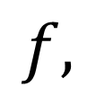
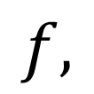
Certified Deletion: Delegation
|
$$⟩$$
$$f,$$
D
|
$$⟩$$
$$f,$$
D

Slide 15
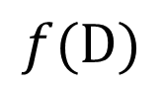
Certified Deletion: Delegation
|
$$⟩$$
$$f,$$
D
|
$$⟩$$
$$f,$$
D
$$f(D)$$

Slide 16
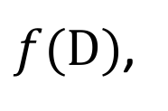
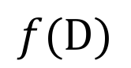

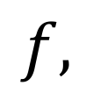
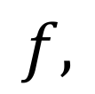
Certified Deletion: Delegation
|
$$⟩$$
$$f,$$
D
|
$$⟩$$
$$f,$$
$f(D)$,
$$f(D)$$

Slide 17
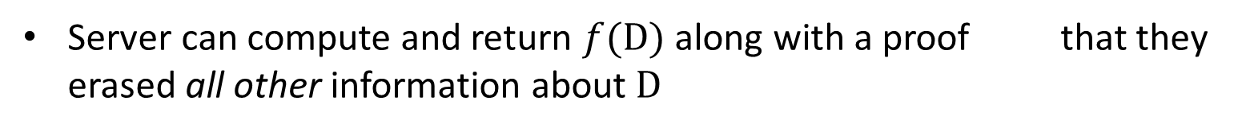
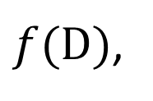
Certified Deletion: Delegation
|
$$⟩$$
$$f,$$
D
|
$$⟩$$
$$f,$$
$f(D)$,
$$f(D)$$
Server can compute and return $f(D)$ along with a proof that they erased all other information about $D$

Slide 18
Certified Deletion: Delegation
[Broadbent, Islam 20]
[Poremba 23]
[B, Garg, Goyal, Khurana,
Malavolta, Raizes, Roberts 23]
|
$$⟩$$
$$f,$$
D
|
$$⟩$$
$$f,$$
$f(D)$,
$$f(D)$$
Server can compute and return $f(D)$ along with a proof that they erased all other information about $D$

Slide 19

Certified Deletion: Timed-Release Encryption
|
$$⟩$$
D

Slide 20


Certified Deletion: Timed-Release Encryption
|
$$⟩$$
D
|
$$⟩$$
After time $T$:
D
D

Slide 21

Certified Deletion: Timed-Release Encryption
|
$$⟩$$
D
Before time $T$:
“Please delete my data”

Slide 22

Certified Deletion: Timed-Release Encryption
|
$$⟩$$
Before time $T$:
“Please delete my data”
Wills
Deposits

Slide 23
Certified Deletion: Timed-Release Encryption
|
$$⟩$$
Before time $T$:
“Please delete my data”
Wills
Deposits

Slide 24
Certified Deletion: Timed-Release Encryption
|
$$⟩$$
Before time $T$:
“Please delete my data”
Wills
Deposits

Slide 25
Certified Deletion: Timed-Release Encryption
[Unruh 13]
[B, Khurana 23]
|
$$⟩$$
Before time $T$:
“Please delete my data”
Wills
Deposits

Slide 26
Outline
Basic scenario and applications
Recipe for constructions
Security
Certifiable deletion of programs

Slide 27
Approach
Modularize: think about the quantum information and crypto components separately
Take advantage of the uncertainty principle
We need states that can simultaneously encode information in two conjugate bases
One basis will encode plaintext information
The other will encode valid deletion certificates

Slide 28
Approach
Modularize: think about the quantum information and crypto components separately
Take advantage of the uncertainty principle
We need states that can simultaneously encode information in two conjugate bases
One basis will encode plaintext information
The other will encode valid deletion certificates

Slide 29
Approach
Modularize: think about the quantum information and crypto components separately
Take advantage of the uncertainty principle
We need states that can simultaneously encode information in two conjugate bases
One basis will encode plaintext information
The other will encode valid deletion certificates

Slide 30
Approach
Modularize: think about the quantum information and crypto components separately
Take advantage of the uncertainty principle
We need states that can simultaneously encode information in two conjugate bases
One basis will encode plaintext information
The other will encode valid deletion certificates

Slide 31
Approach
Modularize: think about the quantum information and crypto components separately
Take advantage of the uncertainty principle
We need states that can simultaneously encode information in two conjugate bases
One basis will encode plaintext information
The other will encode valid deletion certificates

Slide 32
Approach
Modularize: think about the quantum information and crypto components separately
Take advantage of the uncertainty principle
We need states that can simultaneously encode information in two conjugate bases
One basis will encode plaintext information
The other will encode valid deletion certificates

Slide 33
General Recipe

Slide 34
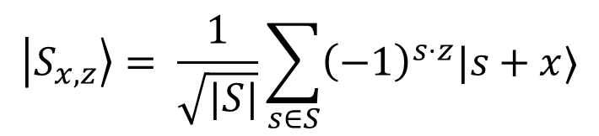
General Recipe
For a subspace $S⊂ 𝔽_{2}^{n}$ and vectors $x∈co\left(S\right),z∈co(S^{⊥})$, define
$$\left|S_{x,z}\right\rangle = \frac{1}{\sqrt{|S|}}\sum_{s∈S}{{\left(−1\right)}^{s⋅z}|s+x⟩}$$

Slide 35
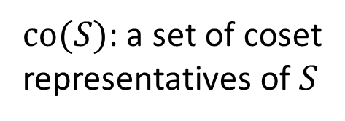
General Recipe
$co(S)$: a set of coset representatives of $S$
For a subspace $S⊂ 𝔽_{2}^{n}$ and vectors $x∈co\left(S\right),z∈co(S^{⊥})$, define
$$\left|S_{x,z}\right\rangle = \frac{1}{\sqrt{|S|}}\sum_{s∈S}{{\left(−1\right)}^{s⋅z}|s+x⟩}$$

Slide 36
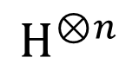
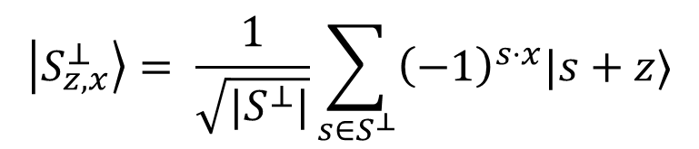
General Recipe
$co(S)$: a set of coset representatives of $S$
For a subspace $S⊂ 𝔽_{2}^{n}$ and vectors $x∈co\left(S\right),z∈co(S^{⊥})$, define
$$\left|S_{x,z}\right\rangle = \frac{1}{\sqrt{|S|}}\sum_{s∈S}{{\left(−1\right)}^{s⋅z}|s+x⟩}$$
$$H^{⊗n}$$
$$\left|S_{z,x}^{⊥}\right\rangle = \frac{1}{\sqrt{|S^{⊥}|}}\sum_{s∈S^{⊥}}{{\left(−1\right)}^{s⋅x}|s+z⟩}$$

Slide 37
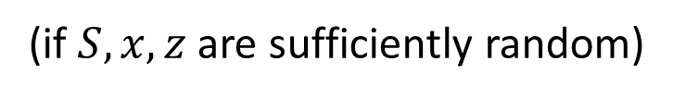
General Recipe
$co(S)$: a set of coset representatives of $S$
For a subspace $S⊂ 𝔽_{2}^{n}$ and vectors $x∈co\left(S\right),z∈co(S^{⊥})$, define
$$\left|S_{x,z}\right\rangle = \frac{1}{\sqrt{|S|}}\sum_{s∈S}{{\left(−1\right)}^{s⋅z}|s+x⟩}$$
$$H^{⊗n}$$
$$\left|S_{z,x}^{⊥}\right\rangle = \frac{1}{\sqrt{|S^{⊥}|}}\sum_{s∈S^{⊥}}{{\left(−1\right)}^{s⋅x}|s+z⟩}$$
Uncertainty principle: $𝒜(|S_{x,z}⟩)⇏(s∈S+x ,s^{′}∈S^{⊥}+z)$
(if $S,x,z$ are sufficiently random)

Slide 38


General Recipe
$co(S)$: a set of coset representatives of $S$
For a subspace $S⊂ 𝔽_{2}^{n}$ and vectors $x∈co\left(S\right),z∈co(S^{⊥})$, define
$$\left|S_{x,z}\right\rangle = \frac{1}{\sqrt{|S|}}\sum_{s∈S}{{\left(−1\right)}^{s⋅z}|s+x⟩}$$
Use $x$ to hide the plaintext
$$H^{⊗n}$$
$$\left|S_{z,x}^{⊥}\right\rangle = \frac{1}{\sqrt{|S^{⊥}|}}\sum_{s∈S^{⊥}}{{\left(−1\right)}^{s⋅x}|s+z⟩}$$
Use $z$ as certificate of deletion
Uncertainty principle: $𝒜(|S_{x,z}⟩)⇏(s∈S+x ,s^{′}∈S^{⊥}+z)$
(if $S,x,z$ are sufficiently random)

Slide 39
General Recipe

Slide 40
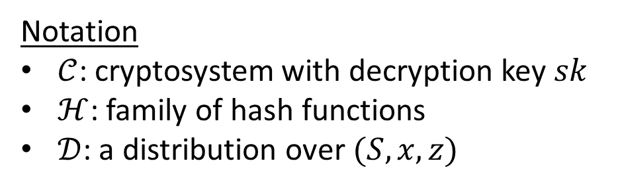
General Recipe
Notation
$𝒞$: cryptosystem with decryption key $sk$
$ℋ$: family of hash functions
$𝒟$: a distribution over $(S,x,z)$

Slide 41
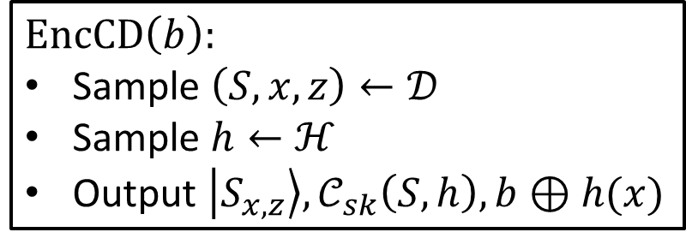
General Recipe
Notation
$𝒞$: cryptosystem with decryption key $sk$
$ℋ$: family of hash functions
$𝒟$: a distribution over $(S,x,z)$
$EncCD\left(b\right):$
Sample $\left(S,x,z\right)←𝒟$
Sample $h←ℋ$
Output $\left|S_{x,z}\right\rangle ,𝒞_{sk}\left(S,h\right),b⊕h(x)$

Slide 42
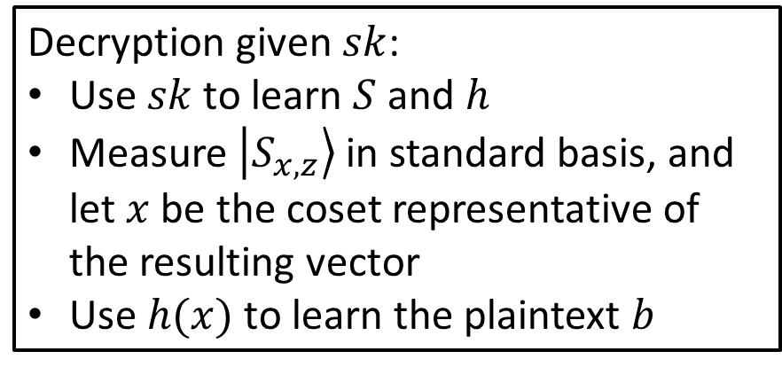
General Recipe
Notation
$𝒞$: cryptosystem with decryption key $sk$
$ℋ$: family of hash functions
$𝒟$: a distribution over $(S,x,z)$
Decryption given $sk$:
Use $sk$ to learn $S$ and $h$
Measure $\left|S_{x,z}\right\rangle$ in standard basis, and let $x$ be the coset representative of the resulting vector
Use $h(x)$ to learn the plaintext $b$
$EncCD\left(b\right):$
Sample $\left(S,x,z\right)←𝒟$
Sample $h←ℋ$
Output $\left|S_{x,z}\right\rangle ,𝒞_{sk}\left(S,h\right),b⊕h(x)$

Slide 43
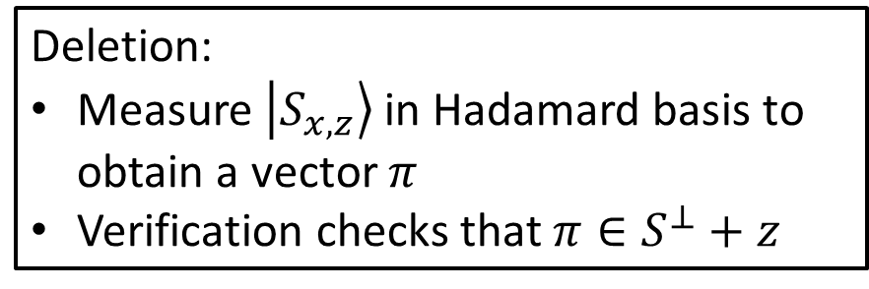
General Recipe
Notation
$𝒞$: cryptosystem with decryption key $sk$
$ℋ$: family of hash functions
$𝒟$: a distribution over $(S,x,z)$
Decryption given $sk$:
Use $sk$ to learn $S$ and $h$
Measure $\left|S_{x,z}\right\rangle$ in standard basis, and let $x$ be the coset representative of the resulting vector
Use $h(x)$ to learn the plaintext $b$
$EncCD\left(b\right):$
Sample $\left(S,x,z\right)←𝒟$
Sample $h←ℋ$
Output $\left|S_{x,z}\right\rangle ,𝒞_{sk}\left(S,h\right),b⊕h(x)$
Deletion:
Measure $\left|S_{x,z}\right\rangle$ in Hadamard basis to obtain a vector $π$
Verification checks that $π∈S^{⊥}+z$

Slide 44
One-time pad
Public-key encryption
Commitment
Timed-release encryption
…
General Recipe
Notation
$𝒞$: cryptosystem with decryption key $sk$
$ℋ$: family of hash functions
$𝒟$: a distribution over $(S,x,z)$
Decryption given $sk$:
Use $sk$ to learn $S$ and $h$
Measure $\left|S_{x,z}\right\rangle$ in standard basis, and let $x$ be the coset representative of the resulting vector
Use $h(x)$ to learn the plaintext $b$
$EncCD\left(b\right):$
Sample $\left(S,x,z\right)←𝒟$
Sample $h←ℋ$
Output $\left|S_{x,z}\right\rangle ,𝒞_{sk}\left(S,h\right),b⊕h(x)$
Deletion:
Measure $\left|S_{x,z}\right\rangle$ in Hadamard basis to obtain a vector $π$
Verification checks that $π∈S^{⊥}+z$

Slide 45
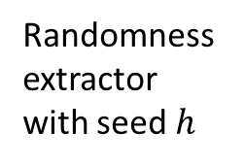
One-time pad
Public-key encryption
Commitment
Timed-release encryption
…
General Recipe
Notation
$𝒞$: cryptosystem with decryption key $sk$
$ℋ$: family of hash functions
$𝒟$: a distribution over $(S,x,z)$
Decryption given $sk$:
Use $sk$ to learn $S$ and $h$
Measure $\left|S_{x,z}\right\rangle$ in standard basis, and let $x$ be the coset representative of the resulting vector
Use $h(x)$ to learn the plaintext $b$
Randomness extractor with seed $h$
$EncCD\left(b\right):$
Sample $\left(S,x,z\right)←𝒟$
Sample $h←ℋ$
Output $\left|S_{x,z}\right\rangle ,𝒞_{sk}\left(S,h\right),b⊕h(x)$
Deletion:
Measure $\left|S_{x,z}\right\rangle$ in Hadamard basis to obtain a vector $π$
Verification checks that $π∈S^{⊥}+z$

Slide 46
One-time pad
Public-key encryption
Commitment
Timed-release encryption
…
General Recipe
Notation
$𝒞$: cryptosystem with decryption key $sk$
$ℋ$: family of hash functions
$𝒟$: a distribution over $(S,x,z)$
Decryption given $sk$:
Use $sk$ to learn $S$ and $h$
Measure $\left|S_{x,z}\right\rangle$ in standard basis, and let $x$ be the coset representative of the resulting vector
Use $h(x)$ to learn the plaintext $b$
Randomness extractor with seed $h$
$EncCD\left(b\right):$
Sample $\left(S,x,z\right)←𝒟$
Sample $h←ℋ$
Output $\left|S_{x,z}\right\rangle ,𝒞_{sk}\left(S,h\right),b⊕h(x)$
Deletion:
Measure $\left|S_{x,z}\right\rangle$ in Hadamard basis to obtain a vector $π$
Verification checks that $π∈S^{⊥}+z$

Slide 47

Instantiatiating the distribution over $S$
Optimize for…

Slide 48
Instantiatiating the distribution over $S$
Optimize for…
Practicality

Slide 49
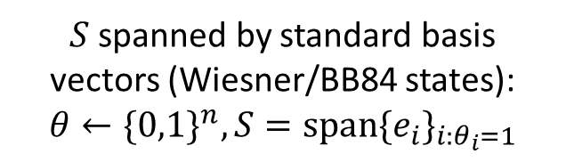
Instantiatiating the distribution over $S$
Optimize for…
Practicality
$S$ spanned by standard basis vectors (Wiesner/BB84 states): $θ←\{0,1\}^{n}, S=span\{e_{i}\}_{i:θ_{i}=1}$

Slide 50
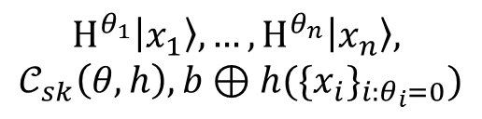
Instantiatiating the distribution over $S$
Optimize for…
Practicality
$S$ spanned by standard basis vectors (Wiesner/BB84 states): $θ←\{0,1\}^{n}, S=span\{e_{i}\}_{i:θ_{i}=1}$
$$H^{θ_{1}}\left|x_{1}\right\rangle ,…,H^{θ_{n}}\left|x_{n}\right\rangle ,$$
$$𝒞_{sk}\left(θ,h\right),b⊕h(\{x_{i}\}_{i:θ_{i}=0})$$

Slide 51
Instantiatiating the distribution over $S$
Optimize for…
Practicality
$S$ spanned by standard basis vectors (Wiesner/BB84 states): $θ←\{0,1\}^{n}, S=span\{e_{i}\}_{i:θ_{i}=1}$
$$H^{θ_{1}}\left|x_{1}\right\rangle ,…,H^{θ_{n}}\left|x_{n}\right\rangle ,$$
$$𝒞_{sk}\left(θ,h\right),b⊕h(\{x_{i}\}_{i:θ_{i}=0})$$
No entanglement required

Slide 52
Instantiatiating the distribution over $S$
Optimize for…
Practicality
$S$ spanned by standard basis vectors (Wiesner/BB84 states): $θ←\{0,1\}^{n}, S=span\{e_{i}\}_{i:θ_{i}=1}$
$$H^{θ_{1}}\left|x_{1}\right\rangle ,…,H^{θ_{n}}\left|x_{n}\right\rangle ,$$
$$𝒞_{sk}\left(θ,h\right),b⊕h(\{x_{i}\}_{i:θ_{i}=0})$$
No entanglement required
[BI20]

Slide 53
Instantiatiating the distribution over $S$
Optimize for…
Practicality
Publicly-Verifiable Deletion
$S$ spanned by standard basis vectors (Wiesner/BB84 states): $θ←\{0,1\}^{n}, S=span\{e_{i}\}_{i:θ_{i}=1}$
$$H^{θ_{1}}\left|x_{1}\right\rangle ,…,H^{θ_{n}}\left|x_{n}\right\rangle ,$$
$$𝒞_{sk}\left(θ,h\right),b⊕h(\{x_{i}\}_{i:θ_{i}=0})$$
No entanglement required
[BI20]

Slide 54
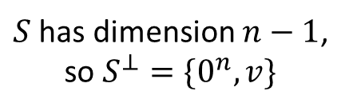
Instantiatiating the distribution over $S$
Optimize for…
Practicality
Publicly-Verifiable Deletion
$S$ spanned by standard basis vectors (Wiesner/BB84 states): $θ←\{0,1\}^{n}, S=span\{e_{i}\}_{i:θ_{i}=1}$
$S$ has dimension $n−1$, so $S^{⊥}=\{0^{n},v\}$
$$H^{θ_{1}}\left|x_{1}\right\rangle ,…,H^{θ_{n}}\left|x_{n}\right\rangle ,$$
$$𝒞_{sk}\left(θ,h\right),b⊕h(\{x_{i}\}_{i:θ_{i}=0})$$
No entanglement required
[BI20]

Slide 55
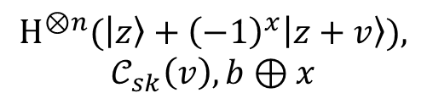
Instantiatiating the distribution over $S$
Optimize for…
Practicality
Publicly-Verifiable Deletion
$S$ spanned by standard basis vectors (Wiesner/BB84 states): $θ←\{0,1\}^{n}, S=span\{e_{i}\}_{i:θ_{i}=1}$
$S$ has dimension $n−1$, so $S^{⊥}=\{0^{n},v\}$
$$H^{θ_{1}}\left|x_{1}\right\rangle ,…,H^{θ_{n}}\left|x_{n}\right\rangle ,$$
$$𝒞_{sk}\left(θ,h\right),b⊕h(\{x_{i}\}_{i:θ_{i}=0})$$
$$H^{⊗n}(\left|z\right\rangle +{\left(−1\right)}^{x}\left|z+v\right\rangle ),$$
$$𝒞_{sk}\left(v\right),b⊕x$$
No entanglement required
[BI20]

Slide 56
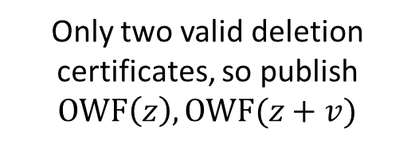
Instantiatiating the distribution over $S$
Optimize for…
Practicality
Publicly-Verifiable Deletion
$S$ spanned by standard basis vectors (Wiesner/BB84 states): $θ←\{0,1\}^{n}, S=span\{e_{i}\}_{i:θ_{i}=1}$
$S$ has dimension $n−1$, so $S^{⊥}=\{0^{n},v\}$
$$H^{θ_{1}}\left|x_{1}\right\rangle ,…,H^{θ_{n}}\left|x_{n}\right\rangle ,$$
$$𝒞_{sk}\left(θ,h\right),b⊕h(\{x_{i}\}_{i:θ_{i}=0})$$
$$H^{⊗n}(\left|z\right\rangle +{\left(−1\right)}^{x}\left|z+v\right\rangle ),$$
$$𝒞_{sk}\left(v\right),b⊕x$$
Only two valid deletion certificates, so publish $OWF\left(z\right),OWF(z+v)$
No entanglement required
[BI20]

Slide 57
Instantiatiating the distribution over $S$
Optimize for…
Practicality
Publicly-Verifiable Deletion
$S$ spanned by standard basis vectors (Wiesner/BB84 states): $θ←\{0,1\}^{n}, S=span\{e_{i}\}_{i:θ_{i}=1}$
$S$ has dimension $n−1$, so $S^{⊥}=\{0^{n},v\}$
$$H^{θ_{1}}\left|x_{1}\right\rangle ,…,H^{θ_{n}}\left|x_{n}\right\rangle ,$$
$$𝒞_{sk}\left(θ,h\right),b⊕h(\{x_{i}\}_{i:θ_{i}=0})$$
$$H^{⊗n}(\left|z\right\rangle +{\left(−1\right)}^{x}\left|z+v\right\rangle ),$$
$$𝒞_{sk}\left(v\right),b⊕x$$
Only two valid deletion certificates, so publish $OWF\left(z\right),OWF(z+v)$
No entanglement required
[BI20]
[BKMPW23]

Slide 58
Instantiatiating the distribution over $S$
Optimize for…
Practicality
Publicly-Verifiable Deletion
Publicly-Verifiable Ciphertext
$S$ spanned by standard basis vectors (Wiesner/BB84 states): $θ←\{0,1\}^{n}, S=span\{e_{i}\}_{i:θ_{i}=1}$
$S$ has dimension $n−1$, so $S^{⊥}=\{0^{n},v\}$
$$H^{θ_{1}}\left|x_{1}\right\rangle ,…,H^{θ_{n}}\left|x_{n}\right\rangle ,$$
$$𝒞_{sk}\left(θ,h\right),b⊕h(\{x_{i}\}_{i:θ_{i}=0})$$
$$H^{⊗n}(\left|z\right\rangle +{\left(−1\right)}^{x}\left|z+v\right\rangle ),$$
$$𝒞_{sk}\left(v\right),b⊕x$$
Only two valid deletion certificates, so publish $OWF\left(z\right),OWF(z+v)$
No entanglement required
[BI20]
[BKMPW23]

Slide 59

Instantiatiating the distribution over $S$
Optimize for…
Practicality
Publicly-Verifiable Deletion
Publicly-Verifiable Ciphertext
$S$ spanned by standard basis vectors (Wiesner/BB84 states): $θ←\{0,1\}^{n}, S=span\{e_{i}\}_{i:θ_{i}=1}$
$S$ has dimension $n−1$, so $S^{⊥}=\{0^{n},v\}$
$S$ uniform over all subspaces
$$H^{θ_{1}}\left|x_{1}\right\rangle ,…,H^{θ_{n}}\left|x_{n}\right\rangle ,$$
$$𝒞_{sk}\left(θ,h\right),b⊕h(\{x_{i}\}_{i:θ_{i}=0})$$
$$H^{⊗n}(\left|z\right\rangle +{\left(−1\right)}^{x}\left|z+v\right\rangle ),$$
$$𝒞_{sk}\left(v\right),b⊕x$$
Only two valid deletion certificates, so publish $OWF\left(z\right),OWF(z+v)$
No entanglement required
[BI20]
[BKMPW23]

Slide 60
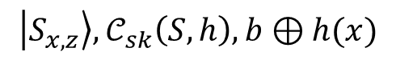
Instantiatiating the distribution over $S$
Optimize for…
Practicality
Publicly-Verifiable Deletion
Publicly-Verifiable Ciphertext
$S$ spanned by standard basis vectors (Wiesner/BB84 states): $θ←\{0,1\}^{n}, S=span\{e_{i}\}_{i:θ_{i}=1}$
$S$ has dimension $n−1$, so $S^{⊥}=\{0^{n},v\}$
$S$ uniform over all subspaces
$$H^{θ_{1}}\left|x_{1}\right\rangle ,…,H^{θ_{n}}\left|x_{n}\right\rangle ,$$
$$𝒞_{sk}\left(θ,h\right),b⊕h(\{x_{i}\}_{i:θ_{i}=0})$$
$$H^{⊗n}(\left|z\right\rangle +{\left(−1\right)}^{x}\left|z+v\right\rangle ),$$
$$𝒞_{sk}\left(v\right),b⊕x$$
$$\left|S_{x,z}\right\rangle ,𝒞_{sk}\left(S,h\right),b⊕h(x)$$
Only two valid deletion certificates, so publish $OWF\left(z\right),OWF(z+v)$
No entanglement required
[BI20]
[BKMPW23]

Slide 61

Instantiatiating the distribution over $S$
Optimize for…
Practicality
Publicly-Verifiable Deletion
Publicly-Verifiable Ciphertext
$S$ spanned by standard basis vectors (Wiesner/BB84 states): $θ←\{0,1\}^{n}, S=span\{e_{i}\}_{i:θ_{i}=1}$
$S$ has dimension $n−1$, so $S^{⊥}=\{0^{n},v\}$
$S$ uniform over all subspaces
$$H^{θ_{1}}\left|x_{1}\right\rangle ,…,H^{θ_{n}}\left|x_{n}\right\rangle ,$$
$$𝒞_{sk}\left(θ,h\right),b⊕h(\{x_{i}\}_{i:θ_{i}=0})$$
$$H^{⊗n}(\left|z\right\rangle +{\left(−1\right)}^{x}\left|z+v\right\rangle ),$$
$$𝒞_{sk}\left(v\right),b⊕x$$
$$\left|S_{x,z}\right\rangle ,𝒞_{sk}\left(S,h\right),b⊕h(x)$$
Only two valid deletion certificates, so publish $OWF\left(z\right),OWF(z+v)$
Secure even given oracle access to $S+x$
No entanglement required
[BI20]
[BKMPW23]

Slide 62
Instantiatiating the distribution over $S$
Optimize for…
Practicality
Publicly-Verifiable Deletion
Publicly-Verifiable Ciphertext
$S$ spanned by standard basis vectors (Wiesner/BB84 states): $θ←\{0,1\}^{n}, S=span\{e_{i}\}_{i:θ_{i}=1}$
$S$ has dimension $n−1$, so $S^{⊥}=\{0^{n},v\}$
$S$ uniform over all subspaces
$$H^{θ_{1}}\left|x_{1}\right\rangle ,…,H^{θ_{n}}\left|x_{n}\right\rangle ,$$
$$𝒞_{sk}\left(θ,h\right),b⊕h(\{x_{i}\}_{i:θ_{i}=0})$$
$$H^{⊗n}(\left|z\right\rangle +{\left(−1\right)}^{x}\left|z+v\right\rangle ),$$
$$𝒞_{sk}\left(v\right),b⊕x$$
$$\left|S_{x,z}\right\rangle ,𝒞_{sk}\left(S,h\right),b⊕h(x)$$
Only two valid deletion certificates, so publish $OWF\left(z\right),OWF(z+v)$
Secure even given oracle access to $S+x$
No entanglement required
[BI20]
[BKMPW23]
[BGGKMRR23]

Slide 63
Outline
Basic scenario and applications
Recipe for constructions
Security
Certifiable deletion of programs

Slide 64


Security Game
[Broadbent, Islam 20]:
$𝒞$ one-time pad
$ℋ$ good randomness extractor
$𝒟$ Wiesner states
$(𝒜_{1},𝒜_{2})$ unbounded
[Hiroka, Morimae, Nishimaki, Yamakawa 21]:
$𝒞$ non-committing encryption scheme
$ℋ$ good randomness extractor
$𝒟$ Wiesner states
$\left(𝒜_{1},𝒜_{2}\right)$ computationally bounded
[B, Khurana 23]:
$𝒞$ semantically-secure distribution
$ℋ$=$⊕$
$𝒟$ Wiesner states
$𝒜_{1}$ computationally bounded, $𝒜_{2}$ unbounded
[B, Garg, Goyal, Khurana, Malavolta, Raizes, Roberts 23]
$𝒞$ subspace-hiding distribution
$ℋ$=$⊕$
$𝒟$ subspace states
$𝒜_{1}$ computationally bounded, $𝒜_{2}$ unbounded

Slide 65
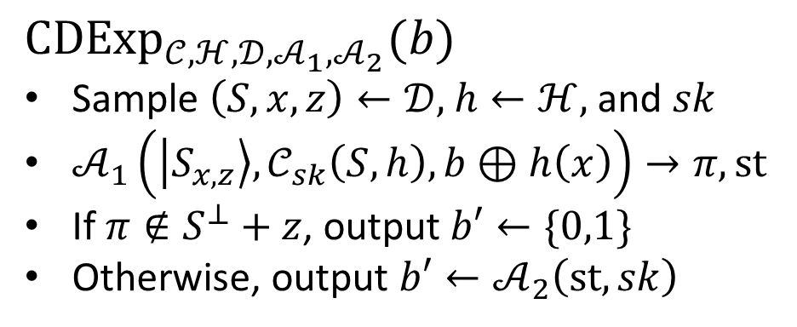
Security Game
${CDExp}_{𝒞,ℋ,𝒟,𝒜_{1},𝒜_{2}}(b)$
Sample $\left(S,x,z\right)←𝒟,$ $h←ℋ,$ and $sk$
$𝒜_{1}\left(\left|S_{x,z}\right\rangle ,𝒞_{sk}\left(S,h\right),b⊕h\left(x\right)\right)→π,st$
If $π∉S^{⊥}+z$, output $b′←\{0,1\}$
Otherwise, output $b′←𝒜_{2}\left(st,sk\right)$
[Broadbent, Islam 20]:
$𝒞$ one-time pad
$ℋ$ good randomness extractor
$𝒟$ Wiesner states
$(𝒜_{1},𝒜_{2})$ unbounded
[Hiroka, Morimae, Nishimaki, Yamakawa 21]:
$𝒞$ non-committing encryption scheme
$ℋ$ good randomness extractor
$𝒟$ Wiesner states
$\left(𝒜_{1},𝒜_{2}\right)$ computationally bounded
[B, Khurana 23]:
$𝒞$ semantically-secure distribution
$ℋ$=$⊕$
$𝒟$ Wiesner states
$𝒜_{1}$ computationally bounded, $𝒜_{2}$ unbounded
[B, Garg, Goyal, Khurana, Malavolta, Raizes, Roberts 23]
$𝒞$ subspace-hiding distribution
$ℋ$=$⊕$
$𝒟$ subspace states
$𝒜_{1}$ computationally bounded, $𝒜_{2}$ unbounded

Slide 66

Security Game
${CDExp}_{𝒞,ℋ,𝒟,𝒜_{1},𝒜_{2}}(b)$
Sample $\left(S,x,z\right)←𝒟,$ $h←ℋ,$ and $sk$
$𝒜_{1}\left(\left|S_{x,z}\right\rangle ,𝒞_{sk}\left(S,h\right),b⊕h\left(x\right)\right)→π,st$
If $π∉S^{⊥}+z$, output $b′←\{0,1\}$
Otherwise, output $b′←𝒜_{2}\left(st,sk\right)$
Want: $\left|Pr\left[{CDExp}_{𝒞,ℋ,𝒟,𝒜_{1},𝒜_{2}}\left(0\right)=1\right]− Pr\left[{CDExp}_{𝒞,ℋ,𝒟,𝒜_{1},𝒜_{2}}\left(1\right)=1\right]\right|=negl$
[Broadbent, Islam 20]:
$𝒞$ one-time pad
$ℋ$ good randomness extractor
$𝒟$ Wiesner states
$(𝒜_{1},𝒜_{2})$ unbounded
[Hiroka, Morimae, Nishimaki, Yamakawa 21]:
$𝒞$ non-committing encryption scheme
$ℋ$ good randomness extractor
$𝒟$ Wiesner states
$\left(𝒜_{1},𝒜_{2}\right)$ computationally bounded
[B, Khurana 23]:
$𝒞$ semantically-secure distribution
$ℋ$=$⊕$
$𝒟$ Wiesner states
$𝒜_{1}$ computationally bounded, $𝒜_{2}$ unbounded
[B, Garg, Goyal, Khurana, Malavolta, Raizes, Roberts 23]
$𝒞$ subspace-hiding distribution
$ℋ$=$⊕$
$𝒟$ subspace states
$𝒜_{1}$ computationally bounded, $𝒜_{2}$ unbounded

Slide 67
Security Game
${CDExp}_{𝒞,ℋ,𝒟,𝒜_{1},𝒜_{2}}(b)$
Sample $\left(S,x,z\right)←𝒟,$ $h←ℋ,$ and $sk$
$𝒜_{1}\left(\left|S_{x,z}\right\rangle ,𝒞_{sk}\left(S,h\right),b⊕h\left(x\right)\right)→π,st$
If $π∉S^{⊥}+z$, output $b′←\{0,1\}$
Otherwise, output $b′←𝒜_{2}\left(st,sk\right)$
Want: $\left|Pr\left[{CDExp}_{𝒞,ℋ,𝒟,𝒜_{1},𝒜_{2}}\left(0\right)=1\right]− Pr\left[{CDExp}_{𝒞,ℋ,𝒟,𝒜_{1},𝒜_{2}}\left(1\right)=1\right]\right|=negl$
History
[Broadbent, Islam 20]:
$𝒞$ one-time pad
$ℋ$ good randomness extractor
$𝒟$ Wiesner states
$(𝒜_{1},𝒜_{2})$ unbounded
[Hiroka, Morimae, Nishimaki, Yamakawa 21]:
$𝒞$ non-committing encryption scheme
$ℋ$ good randomness extractor
$𝒟$ Wiesner states
$\left(𝒜_{1},𝒜_{2}\right)$ computationally bounded
[B, Khurana 23]:
$𝒞$ semantically-secure distribution
$ℋ$=$⊕$
$𝒟$ Wiesner states
$𝒜_{1}$ computationally bounded, $𝒜_{2}$ unbounded
[B, Garg, Goyal, Khurana, Malavolta, Raizes, Roberts 23]
$𝒞$ subspace-hiding distribution
$ℋ$=$⊕$
$𝒟$ subspace states
$𝒜_{1}$ computationally bounded, $𝒜_{2}$ unbounded

Slide 68
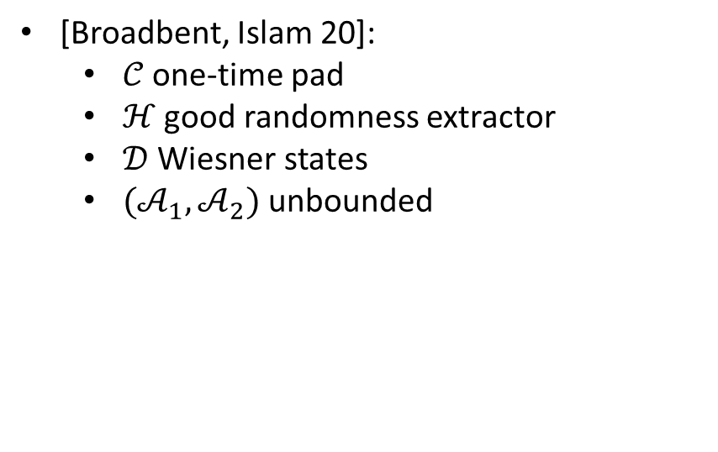
Security Game
${CDExp}_{𝒞,ℋ,𝒟,𝒜_{1},𝒜_{2}}(b)$
Sample $\left(S,x,z\right)←𝒟,$ $h←ℋ,$ and $sk$
$𝒜_{1}\left(\left|S_{x,z}\right\rangle ,𝒞_{sk}\left(S,h\right),b⊕h\left(x\right)\right)→π,st$
If $π∉S^{⊥}+z$, output $b′←\{0,1\}$
Otherwise, output $b′←𝒜_{2}\left(st,sk\right)$
Want: $\left|Pr\left[{CDExp}_{𝒞,ℋ,𝒟,𝒜_{1},𝒜_{2}}\left(0\right)=1\right]− Pr\left[{CDExp}_{𝒞,ℋ,𝒟,𝒜_{1},𝒜_{2}}\left(1\right)=1\right]\right|=negl$
History
[Broadbent, Islam 20]:
$𝒞$ one-time pad
$ℋ$ good randomness extractor
$𝒟$ Wiesner states
$(𝒜_{1},𝒜_{2})$ unbounded
[Hiroka, Morimae, Nishimaki, Yamakawa 21]:
$𝒞$ non-committing encryption scheme
$ℋ$ good randomness extractor
$𝒟$ Wiesner states
$\left(𝒜_{1},𝒜_{2}\right)$ computationally bounded
[B, Khurana 23]:
$𝒞$ semantically-secure distribution
$ℋ$=$⊕$
$𝒟$ Wiesner states
$𝒜_{1}$ computationally bounded, $𝒜_{2}$ unbounded
[B, Garg, Goyal, Khurana, Malavolta, Raizes, Roberts 23]
$𝒞$ subspace-hiding distribution
$ℋ$=$⊕$
$𝒟$ subspace states
$𝒜_{1}$ computationally bounded, $𝒜_{2}$ unbounded

Slide 69
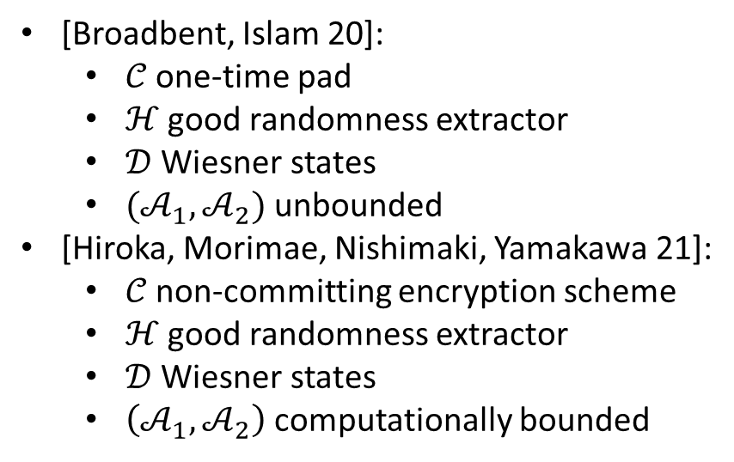
Security Game
${CDExp}_{𝒞,ℋ,𝒟,𝒜_{1},𝒜_{2}}(b)$
Sample $\left(S,x,z\right)←𝒟,$ $h←ℋ,$ and $sk$
$𝒜_{1}\left(\left|S_{x,z}\right\rangle ,𝒞_{sk}\left(S,h\right),b⊕h\left(x\right)\right)→π,st$
If $π∉S^{⊥}+z$, output $b′←\{0,1\}$
Otherwise, output $b′←𝒜_{2}\left(st,sk\right)$
Want: $\left|Pr\left[{CDExp}_{𝒞,ℋ,𝒟,𝒜_{1},𝒜_{2}}\left(0\right)=1\right]− Pr\left[{CDExp}_{𝒞,ℋ,𝒟,𝒜_{1},𝒜_{2}}\left(1\right)=1\right]\right|=negl$
History
[Broadbent, Islam 20]:
$𝒞$ one-time pad
$ℋ$ good randomness extractor
$𝒟$ Wiesner states
$(𝒜_{1},𝒜_{2})$ unbounded
[Hiroka, Morimae, Nishimaki, Yamakawa 21]:
$𝒞$ non-committing encryption scheme
$ℋ$ good randomness extractor
$𝒟$ Wiesner states
$\left(𝒜_{1},𝒜_{2}\right)$ computationally bounded
[B, Khurana 23]:
$𝒞$ semantically-secure distribution
$ℋ$=$⊕$
$𝒟$ Wiesner states
$𝒜_{1}$ computationally bounded, $𝒜_{2}$ unbounded
[B, Garg, Goyal, Khurana, Malavolta, Raizes, Roberts 23]
$𝒞$ subspace-hiding distribution
$ℋ$=$⊕$
$𝒟$ subspace states
$𝒜_{1}$ computationally bounded, $𝒜_{2}$ unbounded

Slide 70
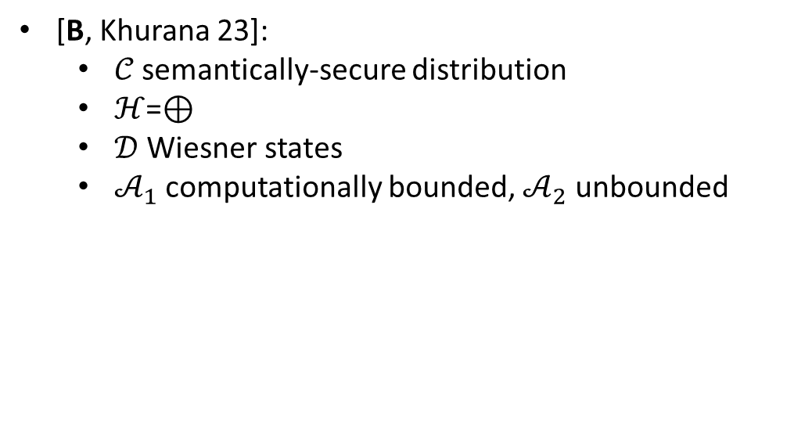
Security Game
${CDExp}_{𝒞,ℋ,𝒟,𝒜_{1},𝒜_{2}}(b)$
Sample $\left(S,x,z\right)←𝒟,$ $h←ℋ,$ and $sk$
$𝒜_{1}\left(\left|S_{x,z}\right\rangle ,𝒞_{sk}\left(S,h\right),b⊕h\left(x\right)\right)→π,st$
If $π∉S^{⊥}+z$, output $b′←\{0,1\}$
Otherwise, output $b′←𝒜_{2}\left(st,sk\right)$
Want: $\left|Pr\left[{CDExp}_{𝒞,ℋ,𝒟,𝒜_{1},𝒜_{2}}\left(0\right)=1\right]− Pr\left[{CDExp}_{𝒞,ℋ,𝒟,𝒜_{1},𝒜_{2}}\left(1\right)=1\right]\right|=negl$
History
[Broadbent, Islam 20]:
$𝒞$ one-time pad
$ℋ$ good randomness extractor
$𝒟$ Wiesner states
$(𝒜_{1},𝒜_{2})$ unbounded
[Hiroka, Morimae, Nishimaki, Yamakawa 21]:
$𝒞$ non-committing encryption scheme
$ℋ$ good randomness extractor
$𝒟$ Wiesner states
$\left(𝒜_{1},𝒜_{2}\right)$ computationally bounded
[B, Khurana 23]:
$𝒞$ semantically-secure distribution
$ℋ$=$⊕$
$𝒟$ Wiesner states
$𝒜_{1}$ computationally bounded, $𝒜_{2}$ unbounded
[B, Garg, Goyal, Khurana, Malavolta, Raizes, Roberts 23]
$𝒞$ subspace-hiding distribution
$ℋ$=$⊕$
$𝒟$ subspace states
$𝒜_{1}$ computationally bounded, $𝒜_{2}$ unbounded

Slide 71
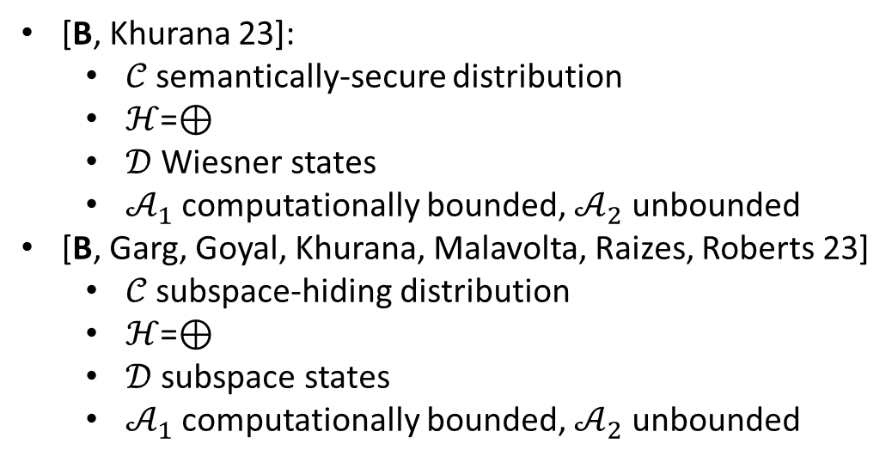
Security Game
${CDExp}_{𝒞,ℋ,𝒟,𝒜_{1},𝒜_{2}}(b)$
Sample $\left(S,x,z\right)←𝒟,$ $h←ℋ,$ and $sk$
$𝒜_{1}\left(\left|S_{x,z}\right\rangle ,𝒞_{sk}\left(S,h\right),b⊕h\left(x\right)\right)→π,st$
If $π∉S^{⊥}+z$, output $b′←\{0,1\}$
Otherwise, output $b′←𝒜_{2}\left(st,sk\right)$
Want: $\left|Pr\left[{CDExp}_{𝒞,ℋ,𝒟,𝒜_{1},𝒜_{2}}\left(0\right)=1\right]− Pr\left[{CDExp}_{𝒞,ℋ,𝒟,𝒜_{1},𝒜_{2}}\left(1\right)=1\right]\right|=negl$
History
[Broadbent, Islam 20]:
$𝒞$ one-time pad
$ℋ$ good randomness extractor
$𝒟$ Wiesner states
$(𝒜_{1},𝒜_{2})$ unbounded
[Hiroka, Morimae, Nishimaki, Yamakawa 21]:
$𝒞$ non-committing encryption scheme
$ℋ$ good randomness extractor
$𝒟$ Wiesner states
$\left(𝒜_{1},𝒜_{2}\right)$ computationally bounded
[B, Khurana 23]:
$𝒞$ semantically-secure distribution
$ℋ$=$⊕$
$𝒟$ Wiesner states
$𝒜_{1}$ computationally bounded, $𝒜_{2}$ unbounded
[B, Garg, Goyal, Khurana, Malavolta, Raizes, Roberts 23]
$𝒞$ subspace-hiding distribution
$ℋ$=$⊕$
$𝒟$ subspace states
$𝒜_{1}$ computationally bounded, $𝒜_{2}$ unbounded

Slide 72
Security Game
${CDExp}_{𝒞,ℋ,𝒟,𝒜_{1},𝒜_{2}}(b)$
Sample $\left(S,x,z\right)←𝒟,$ $h←ℋ,$ and $sk$
$𝒜_{1}\left(\left|S_{x,z}\right\rangle ,𝒞_{sk}\left(S,h\right),b⊕h\left(x\right)\right)→π,st$
If $π∉S^{⊥}+z$, output $b′←\{0,1\}$
Otherwise, output $b′←𝒜_{2}\left(st,sk\right)$
Want: $\left|Pr\left[{CDExp}_{𝒞,ℋ,𝒟,𝒜_{1},𝒜_{2}}\left(0\right)=1\right]− Pr\left[{CDExp}_{𝒞,ℋ,𝒟,𝒜_{1},𝒜_{2}}\left(1\right)=1\right]\right|=negl$
Note: [Unruh 13] showed similar statement for a slightly different template supporting quantum certificates of deletion
History
[Broadbent, Islam 20]:
$𝒞$ one-time pad
$ℋ$ good randomness extractor
$𝒟$ Wiesner states
$(𝒜_{1},𝒜_{2})$ unbounded
[Hiroka, Morimae, Nishimaki, Yamakawa 21]:
$𝒞$ non-committing encryption scheme
$ℋ$ good randomness extractor
$𝒟$ Wiesner states
$\left(𝒜_{1},𝒜_{2}\right)$ computationally bounded
[B, Khurana 23]:
$𝒞$ semantically-secure distribution
$ℋ$=$⊕$
$𝒟$ Wiesner states
$𝒜_{1}$ computationally bounded, $𝒜_{2}$ unbounded
[B, Garg, Goyal, Khurana, Malavolta, Raizes, Roberts 23]
$𝒞$ subspace-hiding distribution
$ℋ$=$⊕$
$𝒟$ subspace states
$𝒜_{1}$ computationally bounded, $𝒜_{2}$ unbounded

Slide 73
Example Proof

Slide 74
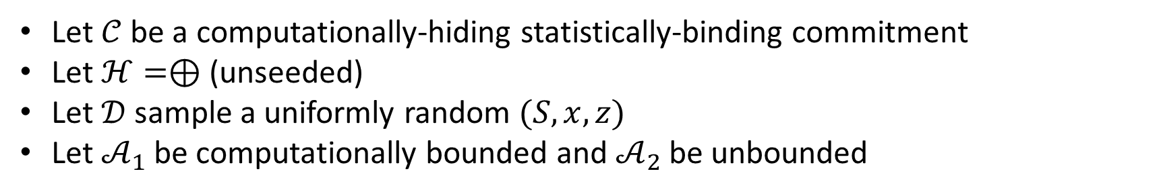
Example Proof
Let $𝒞$ be a computationally-hiding statistically-binding commitment
Let $ℋ=⊕$ (unseeded)
Let $𝒟$ sample a uniformly random $(S,x,z)$
Let $𝒜_{1}$ be computationally bounded and $𝒜_{2}$ be unbounded

Slide 75
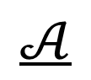
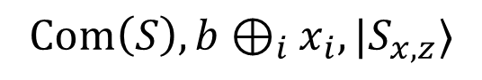

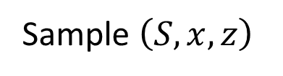
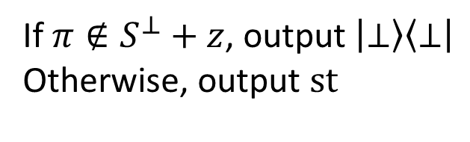
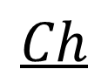
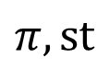
Example Proof
Let $𝒞$ be a computationally-hiding statistically-binding commitment
Let $ℋ=⊕$ (unseeded)
Let $𝒟$ sample a uniformly random $(S,x,z)$
Let $𝒜_{1}$ be computationally bounded and $𝒜_{2}$ be unbounded
$$𝒜$$
$${Hyb}_{0}\left(b\right)$$
$$Ch$$
Sample $\left(S,x,z\right)$
$$Com\left(S\right),b⊕_{i}x_{i},|S_{x,z}⟩$$
$$π,st$$
If $π∉S^{⊥}+z$, output $\left|⊥\right\rangle \left\langle ⊥\right|$
Otherwise, output $st$

Slide 76
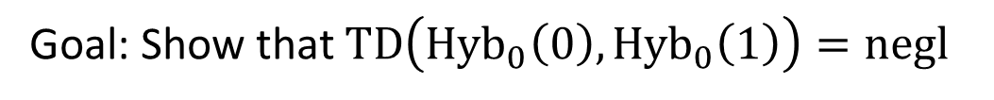
Example Proof
Let $𝒞$ be a computationally-hiding statistically-binding commitment
Let $ℋ=⊕$ (unseeded)
Let $𝒟$ sample a uniformly random $(S,x,z)$
Let $𝒜_{1}$ be computationally bounded and $𝒜_{2}$ be unbounded
$$𝒜$$
$${Hyb}_{0}\left(b\right)$$
$$Ch$$
Sample $\left(S,x,z\right)$
$$Com\left(S\right),b⊕_{i}x_{i},|S_{x,z}⟩$$
$$π,st$$
If $π∉S^{⊥}+z$, output $\left|⊥\right\rangle \left\langle ⊥\right|$
Otherwise, output $st$
Goal: Show that $TD\left({Hyb}_{0}\left(0\right),{Hyb}_{0}\left(1\right)\right)=negl$

Slide 77
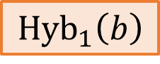
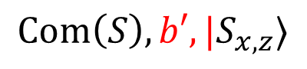
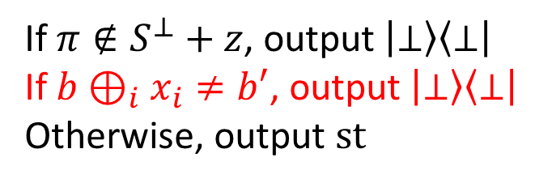
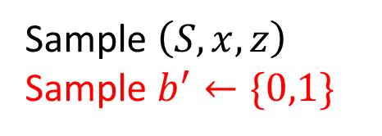
Example Proof
Hybrid 1: Delay the dependence of the experiment on $b$
$$𝒜$$
$${Hyb}_{1}\left(b\right)$$
$$Ch$$
Sample $\left(S,x,z\right)$
Sample $b^{′}←\{0,1\}$
$$Com\left(S\right),b′,|S_{x,z}⟩$$
$$π,st$$
If $π∉S^{⊥}+z$, output $\left|⊥\right\rangle \left\langle ⊥\right|$
If $b⊕_{i}x_{i}≠b′$, output $\left|⊥\right\rangle \left\langle ⊥\right|$
Otherwise, output $st$

Slide 78
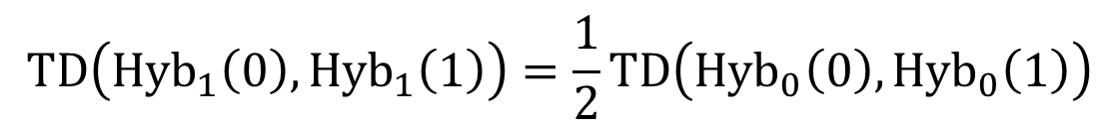
Example Proof
Hybrid 1: Delay the dependence of the experiment on $b$
$$TD\left({Hyb}_{1}\left(0\right),{Hyb}_{1}\left(1\right)\right)=\frac{1}{2}TD\left({Hyb}_{0}\left(0\right),{Hyb}_{0}\left(1\right)\right)$$
$$𝒜$$
$${Hyb}_{1}\left(b\right)$$
$$Ch$$
Sample $\left(S,x,z\right)$
Sample $b^{′}←\{0,1\}$
$$Com\left(S\right),b′,|S_{x,z}⟩$$
$$π,st$$
If $π∉S^{⊥}+z$, output $\left|⊥\right\rangle \left\langle ⊥\right|$
If $b⊕_{i}x_{i}≠b′$, output $\left|⊥\right\rangle \left\langle ⊥\right|$
Otherwise, output $st$

Slide 79

Example Proof
Hybrid 1: Delay the dependence of the experiment on $b$
$$TD\left({Hyb}_{1}\left(0\right),{Hyb}_{1}\left(1\right)\right)=\frac{1}{2}TD\left({Hyb}_{0}\left(0\right),{Hyb}_{0}\left(1\right)\right)$$
$$𝒜$$
$${Hyb}_{1}\left(b\right)$$
$$Ch$$
Sample $\left(S,x,z\right)$
Sample $b^{′}←\{0,1\}$
$$Com\left(S\right),b′,|S_{x,z}⟩$$
$$π,st$$
If $π∉S^{⊥}+z$, output $\left|⊥\right\rangle \left\langle ⊥\right|$
If $b⊕_{i}x_{i}≠b′$, output $\left|⊥\right\rangle \left\langle ⊥\right|$
Otherwise, output $st$
Remains to show that $x$ has a lot of conditional min-entropy

Slide 80
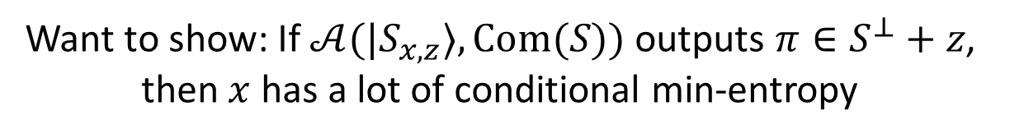
Example Proof
Want to show: If $𝒜(|S_{x,z}⟩, Com(S))$ outputs $π∈S^{⊥}+z$, then $x$ has a lot of conditional min-entropy

Slide 81
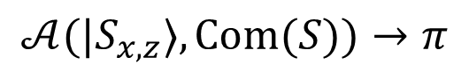
Example Proof
Want to show: If $𝒜(|S_{x,z}⟩, Com(S))$ outputs $π∈S^{⊥}+z$, then $x$ has a lot of conditional min-entropy
$$𝒜(|S_{x,z}⟩, Com(S))→π$$

Slide 82
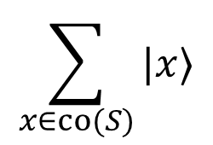
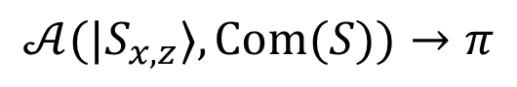
Example Proof
Want to show: If $𝒜(|S_{x,z}⟩, Com(S))$ outputs $π∈S^{⊥}+z$, then $x$ has a lot of conditional min-entropy
$$𝒜(|S_{x,z}⟩, Com(S))→π$$
Purify
$$\sum_{x∈co(S)}{|x⟩}$$
$$𝒜(|S_{x,z}⟩, Com(S))→π$$

Slide 83
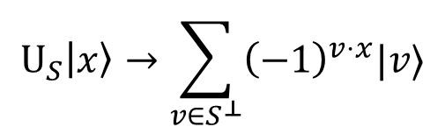
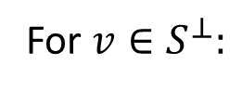
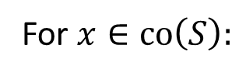

Example Proof
Want to show: If $𝒜(|S_{x,z}⟩, Com(S))$ outputs $π∈S^{⊥}+z$, then $x$ has a lot of conditional min-entropy
$$𝒜(|S_{x,z}⟩, Com(S))→π$$
Purify
$$U_{S}\left|x\right\rangle →\sum_{v∈S^{⊥}}{{\left(−1\right)}^{v⋅x}|v⟩}$$
$$\sum_{x∈co(S)}{|x⟩}$$
For $x∈co\left(S\right):$
$$𝒜(|S_{x,z}⟩, Com(S))→π$$
$$U_{S}^{†}\left|v\right\rangle →\sum_{x∈co(S)}{{\left(−1\right)}^{v⋅x}|x⟩}$$
For $v∈S^{⊥}:$

Slide 84



Example Proof
Want to show: If $𝒜(|S_{x,z}⟩, Com(S))$ outputs $π∈S^{⊥}+z$, then $x$ has a lot of conditional min-entropy
$$𝒜(|S_{x,z}⟩, Com(S))→π$$
Purify
$$U_{S}\left|x\right\rangle →\sum_{v∈S^{⊥}}{{\left(−1\right)}^{v⋅x}|v⟩}$$
$$\sum_{x∈co(S)}{|x⟩}$$
For $x∈co\left(S\right):$
$$𝒜(|S_{x,z}⟩, Com(S))→π$$
$$U_{S}$$
$$U_{S}^{†}\left|v\right\rangle →\sum_{x∈co(S)}{{\left(−1\right)}^{v⋅x}|x⟩}$$
For $v∈S^{⊥}:$
$$\sum_{v∈S^{⊥}}{|v⟩}$$
$$𝒜(\sum_{w}{{\left(−1\right)}^{w⋅(z+v)}|w⟩}, Com(S))→π$$

Slide 85


Example Proof
Want to show: If $𝒜(|S_{x,z}⟩, Com(S))$ outputs $π∈S^{⊥}+z$, then $x$ has a lot of conditional min-entropy
$$𝒜(|S_{x,z}⟩, Com(S))→π$$
Purify
$$U_{S}\left|x\right\rangle →\sum_{v∈S^{⊥}}{{\left(−1\right)}^{v⋅x}|v⟩}$$
$$\sum_{x∈co(S)}{|x⟩}$$
For $x∈co\left(S\right):$
$$𝒜(|S_{x,z}⟩, Com(S))→π$$
$$U_{S}$$
$$U_{S}^{†}\left|v\right\rangle →\sum_{x∈co(S)}{{\left(−1\right)}^{v⋅x}|x⟩}$$
For $v∈S^{⊥}:$
$$\sum_{v∈S^{⊥}}{|v⟩}$$
$$𝒜(H^{⊗n}|v+z⟩, Com(S))→π$$

Slide 86

Example Proof
Want to show: If $𝒜(|S_{x,z}⟩, Com(S))$ outputs $π∈S^{⊥}+z$, then $x$ has a lot of conditional min-entropy
$$𝒜(|S_{x,z}⟩, Com(S))→π$$
Purify
$$U_{S}\left|x\right\rangle →\sum_{v∈S^{⊥}}{{\left(−1\right)}^{v⋅x}|v⟩}$$
$$\sum_{x∈co(S)}{|x⟩}$$
For $x∈co\left(S\right):$
$$𝒜(|S_{x,z}⟩, Com(S))→π$$
$$U_{S}$$
$$U_{S}^{†}\left|v\right\rangle →\sum_{x∈co(S)}{{\left(−1\right)}^{v⋅x}|x⟩}$$
For $v∈S^{⊥}:$
$$\sum_{v∈S^{⊥}}{|v⟩}$$
$$𝒜(H^{⊗n}|v+z⟩, Com(S))→π$$
Claim: if $𝒜$ given random $v+z$ and outputs $π∈S^{⊥}+z$, then $π=v+z$with overwhelming probability (over $S,z$)

Slide 87

Example Proof
Want to show: If $𝒜(|S_{x,z}⟩, Com(S))$ outputs $π∈S^{⊥}+z$, then $x$ has a lot of conditional min-entropy
$$𝒜(|S_{x,z}⟩, Com(S))→π$$
Purify
$$U_{S}\left|x\right\rangle →\sum_{v∈S^{⊥}}{{\left(−1\right)}^{v⋅x}|v⟩}$$
$$\sum_{x∈co(S)}{|x⟩}$$
For $x∈co\left(S\right):$
$$𝒜(|S_{x,z}⟩, Com(S))→π$$
$$U_{S}$$
$$U_{S}^{†}\left|v\right\rangle →\sum_{x∈co(S)}{{\left(−1\right)}^{v⋅x}|x⟩}$$
For $v∈S^{⊥}:$
$$\sum_{v∈S^{⊥}}{|v⟩}$$
$$𝒜(H^{⊗n}|v+z⟩, Com(S))→π$$
Project
Claim: if $𝒜$ given random $v+z$ and outputs $π∈S^{⊥}+z$, then $π=v+z$with overwhelming probability (over $S,z$)
$$|π−z⟩$$

Slide 88


Example Proof
Want to show: If $𝒜(|S_{x,z}⟩, Com(S))$ outputs $π∈S^{⊥}+z$, then $x$ has a lot of conditional min-entropy
$$𝒜(|S_{x,z}⟩, Com(S))→π$$
Purify
$$U_{S}\left|x\right\rangle →\sum_{v∈S^{⊥}}{{\left(−1\right)}^{v⋅x}|v⟩}$$
$$\sum_{x∈co(S)}{|x⟩}$$
For $x∈co\left(S\right):$
$$𝒜(|S_{x,z}⟩, Com(S))→π$$
$$U_{S}$$
$$U_{S}^{†}\left|v\right\rangle →\sum_{x∈co(S)}{{\left(−1\right)}^{v⋅x}|x⟩}$$
For $v∈S^{⊥}:$
$$\sum_{v∈S^{⊥}}{|v⟩}$$
$$𝒜(H^{⊗n}|v+z⟩, Com(S))→π$$
Project
Claim: if $𝒜$ given random $v+z$ and outputs $π∈S^{⊥}+z$, then $π=v+z$with overwhelming probability (over $S,z$)
$$|π−z⟩$$
$$U_{S}^{†}$$
$$\sum_{x∈co(S)}{{\left(−1\right)}^{(π−z)⋅x}|x⟩}$$

Slide 89

Example Proof
Want to show: If $𝒜(|S_{x,z}⟩, Com(S))$ outputs $π∈S^{⊥}+z$, then $x$ has a lot of conditional min-entropy
$$𝒜(|S_{x,z}⟩, Com(S))→π$$
Purify
$$U_{S}\left|x\right\rangle →\sum_{v∈S^{⊥}}{{\left(−1\right)}^{v⋅x}|v⟩}$$
$$\sum_{x∈co(S)}{|x⟩}$$
For $x∈co\left(S\right):$
$$𝒜(|S_{x,z}⟩, Com(S))→π$$
$$U_{S}$$
$$U_{S}^{†}\left|v\right\rangle →\sum_{x∈co(S)}{{\left(−1\right)}^{v⋅x}|x⟩}$$
For $v∈S^{⊥}:$
$$\sum_{v∈S^{⊥}}{|v⟩}$$
$$𝒜(H^{⊗n}|v+z⟩, Com(S))→π$$
Project
Claim: if $𝒜$ given random $v+z$ and outputs $π∈S^{⊥}+z$, then $π=v+z$with overwhelming probability (over $S,z$)
$$|π−z⟩$$
$$U_{S}^{†}$$
$$\sum_{x∈co(S)}{{\left(−1\right)}^{(π−z)⋅x}|x⟩}$$
Measuring gives a uniformly random $x∈co(S)$, independent of $𝒜$’s view

Slide 90
Outline
Basic scenario and applications
Recipe for constructions
Security
Certifiable deletion of programs

Slide 91
Plan
(Indistinguishability) obfuscation with certified deletion
Applications
Comparison with other notions
copy-protection
copy-detection
revocable crypto / key leasing
secure software leasing

Slide 92

Obfuscation with Certified Deletion
Rough goal:
Encode a program $f$ into a deletable quantum state
Before deletion, the program is useful in some way, after deletion it is not

Slide 93

Obfuscation with Certified Deletion
Rough goal:
Encode a program $f$ into a deletable quantum state
Before deletion, the program is useful in some way, after deletion it is not

Slide 94

Obfuscation with Certified Deletion
Rough goal:
Encode a program $f$ into a deletable quantum state
Before deletion, the program is useful in some way, after deletion it is not

Slide 95

Obfuscation with Certified Deletion
Rough goal:
Encode a program $f$ into a deletable quantum state
Before deletion, the program is useful in some way, after deletion it is not

Slide 96


Obfuscation with Certified Deletion
Rough goal:
Encode a program $f$ into a deletable quantum state
Before deletion, the program is useful in some way, after deletion it is not
Candidate construction:
$$\left|S_{x,z}\right\rangle ,CObf\left(P[S,f⊕x]\right)$$
[BGGKMRR23]
$P\left[S,\tilde{f}\right]\left(y,v\right):$
Let $x$ be the coset of $S$ that $v$ belongs to
Let $f=\tilde{f}⊕x$
Output $f(y)$

Slide 97
Obfuscation with Certified Deletion
A “one-way” compiler that scrambles the description of a circuit while maintaining its functionality
Rough goal:
Encode a program $f$ into a deletable quantum state
Before deletion, the program is useful in some way, after deletion it is not
Candidate construction:
$$\left|S_{x,z}\right\rangle ,CObf\left(P[S,f⊕x]\right)$$
[BGGKMRR23]
$P\left[S,\tilde{f}\right]\left(y,v\right):$
Let $x$ be the coset of $S$ that $v$ belongs to
Let $f=\tilde{f}⊕x$
Output $f(y)$

Slide 98




Obfuscation with Certified Deletion
Rough goal:
Encode a program $f$ into a deletable quantum state
Before deletion, the program is useful in some way, after deletion it is not
Candidate construction:
$$\left|S_{x,z}\right\rangle ,CObf\left(P[S,f⊕x]\right)$$
[BGGKMRR23]
$P\left[S,\tilde{f}\right]\left(y,v\right):$
Let $x$ be the coset of $S$ that $v$ belongs to
Let $f=\tilde{f}⊕x$
Output $f(y)$
Correctness:
Given any input $y$, evaluate $Obf\left(P[S,f⊕x]\right)$ on $y$ and in superposition over $S+x$ to learn $f(y)$

Slide 99


Obfuscation with Certified Deletion
Rough goal:
Encode a program $f$ into a deletable quantum state
Before deletion, the program is useful in some way, after deletion it is not
Candidate construction:
$$\left|S_{x,z}\right\rangle ,CObf\left(P[S,f⊕x]\right)$$
[BGGKMRR23]
$P\left[S,\tilde{f}\right]\left(y,v\right):$
Let $x$ be the coset of $S$ that $v$ belongs to
Let $f=\tilde{f}⊕x$
Output $f(y)$
Issue with security:
By querying on different $v∉S+x$, can potentially learn evaluations of functions whose description is related to $f$

Slide 100
Obfuscation with Certified Deletion
Rough goal:
Encode a program $f$ into a deletable quantum state
Before deletion, the program is useful in some way, after deletion it is not
Candidate construction:
$$\left|S_{x,z}\right\rangle ,CObf\left(P[S,f⊕x]\right)$$
[BGGKMRR23]
$P\left[S,\tilde{f}\right]\left(y,v\right):$
Let $x$ be the coset of $S$ that $v$ belongs to
Let $f=\tilde{f}⊕x$
Output $f(y)$
Solution:
$P$ should only accept authentic vectors $v$ derived from the state $\left|S_{x,z}\right\rangle$

Slide 101



Obfuscation with Certified Deletion
Rough goal:
Encode a program $f$ into a deletable quantum state
Before deletion, the program is useful in some way, after deletion it is not
Candidate construction:
$$\left|S_{x,z}\right\rangle ,CObf\left(P[S,T,u,f⊕x]\right)$$
[BGGKMRR23]
$P\left[S,T,u,\tilde{f}\right]\left(y,v\right):$
Abort if $v∉T+u$
Let $x$ be the coset of $S$ that $v$ belongs to
Let $f=\tilde{f}⊕x$
Output $f(y)$
Solution:
$P$ should only accept authentic vectors $v$ derived from the state $\left|S_{x,z}\right\rangle$
Define authentic vectors via a random superspace $T+u⊃S+x$
Hard for the adversary to query on any authentic vector not in $S+x$

Slide 102

Obfuscation with Certified Deletion
Rough goal:
Encode a program $f$ into a deletable quantum state
Before deletion, the program is useful in some way, after deletion it is not
Candidate construction:
$$\left|S_{x,z}\right\rangle ,CObf\left(P[S,T,u,f⊕x]\right)$$
[BGGKMRR23]
$P\left[S,T,u,\tilde{f}\right]\left(y,v\right):$
Abort if $v∉T+u$
Let $x$ be the coset of $S$ that $v$ belongs to
Let $f=\tilde{f}⊕x$
Output $f(y)$
Solution:
$P$ should only accept authentic vectors $v$ derived from the state $\left|S_{x,z}\right\rangle$
Define authentic vectors via a random superspace $T+u⊃S+x$
Hard for the adversary to query on any authentic vector not in $S+x$

Slide 103




Obfuscation with Certified Deletion
If $CObf$ is modeled as a classical oracle:
Before deletion, evaluator can use the oracle to learn $f(y)$ for any $y$ of their choice
After deletion (outputting $v∈S^{⊥}+z$), the evaluator cannot learn anything else from the oracle even given unbounded queries
Candidate construction:
$$\left|S_{x,z}\right\rangle ,CObf\left(P[S,T,u,f⊕x]\right)$$
[BGGKMRR23]
$P\left[S,T,u,\tilde{f}\right]\left(y,v\right):$
Abort if $v∉T+u$
Let $x$ be the coset of $S$ that $v$ belongs to
Let $f=\tilde{f}⊕x$
Output $f(y)$
Solution:
$P$ should only accept authentic vectors $v$ derived from the state $\left|S_{x,z}\right\rangle$
Define authentic vectors via a random superspace $T+u⊃S+x$
Hard for the adversary to query on any authentic vector not in $S+x$

Slide 104

Without Oracles…
Indistinguishability obfuscation
For any two functionally equivalent circuits $C_{0},C_{1}, Obf\left(C_{0}\right)≈_{c}Obf(C_{1})$

Slide 105

Without Oracles…
Indistinguishability obfuscation
For any two functionally equivalent circuits $C_{0},C_{1}, Obf\left(C_{0}\right)≈_{c}Obf(C_{1})$

Slide 106

Without Oracles…
Indistinguishability obfuscation
For any two functionally equivalent circuits $C_{0},C_{1}, Obf\left(C_{0}\right)≈_{c}Obf(C_{1})$

Slide 107

Without Oracles…
Indistinguishability obfuscation with certified deletion
For any two functionally equivalent circuits $C_{0},C_{1}, Obf\left(C_{0}\right)≈_{c}Obf(C_{1})$, and after deletion $Obf\left(C_{0}\right)≈_{s}Obf(C_{1})$
Satisfied by a slightly modified construction
Seems like a weak guarantee, but (differing inputs) iO with CD are useful tools:
Two-message delegation with certified deletion
A generic compiler from encryption to encryption with revocable secret keys

Slide 108

Without Oracles…
Indistinguishability obfuscation with certified deletion
For any two functionally equivalent circuits $C_{0},C_{1}, Obf\left(C_{0}\right)≈_{c}Obf(C_{1})$, and after deletion $Obf\left(C_{0}\right)≈_{s}Obf(C_{1})$
Satisfied by a slightly modified construction
Seems like a weak guarantee, but (differing inputs) iO with CD are useful tools:
Two-message delegation with certified deletion
A generic compiler from encryption to encryption with revocable secret keys

Slide 109

Without Oracles…
Indistinguishability obfuscation with certified deletion
For any two functionally equivalent circuits $C_{0},C_{1}, Obf\left(C_{0}\right)≈_{c}Obf(C_{1})$, and after deletion $Obf\left(C_{0}\right)≈_{s}Obf(C_{1})$
Satisfied by a slightly modified construction
Seems like a weak guarantee, but (differing inputs) iO with CD are useful tools:
Two-message delegation with certified deletion
A generic compiler from encryption to encryption with revocable secret keys

Slide 110

Without Oracles…
Indistinguishability obfuscation with certified deletion
For any two functionally equivalent circuits $C_{0},C_{1}, Obf\left(C_{0}\right)≈_{c}Obf(C_{1})$, and after deletion $Obf\left(C_{0}\right)≈_{s}Obf(C_{1})$
Satisfied by a slightly modified construction
Seems like a weak guarantee, but (differing inputs) iO with CD are useful tools:
Two-message delegation with certified deletion
A generic compiler from encryption to encryption with revocable secret keys

Slide 111

Without Oracles…
Indistinguishability obfuscation with certified deletion
For any two functionally equivalent circuits $C_{0},C_{1}, Obf\left(C_{0}\right)≈_{c}Obf(C_{1})$, and after deletion $Obf\left(C_{0}\right)≈_{s}Obf(C_{1})$
Satisfied by a slightly modified construction
Seems like a weak guarantee, but (differing inputs) iO with CD are useful tools:
Two-message delegation with certified deletion
A generic compiler from encryption to encryption with revocable secret keys

Slide 112


Encryption with Revocable / Deletable Secret Keys
$Gen→pk,vk,|sk⟩$
$Enc\left(pk,m\right)→ct$
$Dec\left(|sk⟩,ct\right)→m$
$Del(|sk⟩)→cert$
$Ver\left(vk,cert\right)→⊤/⊥$
Simple compiler: $\left|sk\right\rangle =iOCD(Dec(sk,⋅))$ [BGGMKRR23]
Gives publicly-verifiable revocation if iOCD is publicly verifiable
Privately-verifiable revocation from standard assumptions: [Kitagawa, Nishimaki 22], [Agarwal, Kitagawa, Nishimaki, Yamada, Yamakawa 23], [Ananth, Poremba, Vaikuntanathan 23]

Slide 113

Encryption with Revocable / Deletable Secret Keys
$Gen→pk,vk,|sk⟩$
$Enc\left(pk,m\right)→ct$
$Dec\left(|sk⟩,ct\right)→m$
$Del(|sk⟩)→cert$
$Ver\left(vk,cert\right)→⊤/⊥$
Deletion security: ciphertexts generated after successful deletion of $|sk⟩$ are semantically secure
Simple compiler: $\left|sk\right\rangle =iOCD(Dec(sk,⋅))$ [BGGMKRR23]
Gives publicly-verifiable revocation if iOCD is publicly verifiable
Privately-verifiable revocation from standard assumptions: [Kitagawa, Nishimaki 22], [Agarwal, Kitagawa, Nishimaki, Yamada, Yamakawa 23], [Ananth, Poremba, Vaikuntanathan 23]

Slide 114

Encryption with Revocable / Deletable Secret Keys
$Gen→pk,vk,|sk⟩$
$Enc\left(pk,m\right)→ct$
$Dec\left(|sk⟩,ct\right)→m$
$Del(|sk⟩)→cert$
$Ver\left(vk,cert\right)→⊤/⊥$
Deletion security: ciphertexts generated after successful deletion of $|sk⟩$ are semantically secure
Simple compiler: $\left|sk\right\rangle =iOCD(Dec(sk,⋅))$ [BGGMKRR23]
Gives publicly-verifiable revocation if iOCD is publicly verifiable
Privately-verifiable revocation from standard assumptions: [Kitagawa, Nishimaki 22], [Agarwal, Kitagawa, Nishimaki, Yamada, Yamakawa 23], [Ananth, Poremba, Vaikuntanathan 23]

Slide 115

Encryption with Revocable / Deletable Secret Keys
$Gen→pk,vk,|sk⟩$
$Enc\left(pk,m\right)→ct$
$Dec\left(|sk⟩,ct\right)→m$
$Del(|sk⟩)→cert$
$Ver\left(vk,cert\right)→⊤/⊥$
Deletion security: ciphertexts generated after successful deletion of $|sk⟩$ are semantically secure
Simple compiler: $\left|sk\right\rangle =iOCD(Dec(sk,⋅))$ [BGGMKRR23]
Gives publicly-verifiable revocation if iOCD is publicly verifiable
Privately-verifiable revocation from standard assumptions: [Kitagawa, Nishimaki 22], [Agarwal, Kitagawa, Nishimaki, Yamada, Yamakawa 23], [Ananth, Poremba, Vaikuntanathan 23]

Slide 116

Encryption with Revocable / Deletable Secret Keys
$Gen→pk,vk,|sk⟩$
$Enc\left(pk,m\right)→ct$
$Dec\left(|sk⟩,ct\right)→m$
$Del(|sk⟩)→cert$
$Ver\left(vk,cert\right)→⊤/⊥$
Deletion security: ciphertexts generated after successful deletion of $|sk⟩$ are semantically secure
Simple compiler: $\left|sk\right\rangle =iOCD(Dec(sk,⋅))$ [BGGMKRR23]
Gives publicly-verifiable revocation if iOCD is publicly verifiable
Privately-verifiable revocation from standard assumptions: [Kitagawa, Nishimaki 22], [Agarwal, Kitagawa, Nishimaki, Yamada, Yamakawa 23], [Ananth, Poremba, Vaikuntanathan 23]

Slide 117


Related Notions
Hard for the adversary to produce…
“working” copy of a program
certificate derived from program
privately verifiable
publicly verifiable

Slide 118
Related Notions
Hard for the adversary to produce…
Copy Protection:
[Aaronson 09]
“working” copy of a program
certificate derived from program
privately verifiable
publicly verifiable

Slide 119
Related Notions
Hard for the adversary to produce…
Copy Protection:
[Aaronson 09]
Copy Detection / Infinite-Term Secure Software Leasing:
[Ananth, La Placa 21], [Aaronson, Liu, Liu, Zhandry, Zhang 22]
Finite-Term Secure Software Leasing:
[AL21]
“working” copy of a program
certificate derived from program
privately verifiable
publicly verifiable

Slide 120
Related Notions
Hard for the adversary to produce…
Copy Protection:
[Aaronson 09]
Publicly-Verifiable Deletion / Revocation:
[BGGKMRR23]
Privately-Verifiable Deletion / Revocation:
[KN22], [AKNYY23], [APV23]
Copy Detection / Infinite-Term Secure Software Leasing:
[Ananth, La Placa 21], [Aaronson, Liu, Liu, Zhandry, Zhang 22]
Finite-Term Secure Software Leasing:
[AL21]
“working” copy of a program
certificate derived from program
privately verifiable
publicly verifiable

Slide 121

Future Directions
Prove the security of ${CDExp}_{𝒞,ℋ,𝒟,𝒜_{1},𝒜_{2}}$ when
Encoding super-logarithmic bits per subspace state
$𝒞$ is any semantically-secure distribution and $ℋ$ is a good seeded randomness extractor
Robustness to noise (beyond one-time pad [BI20])
Publicly-verifiable revocation/deletion without post-quantum iO
More rigorous understanding of the relationship between unclonable primitives from previous slide ([Ananth, Kaleoglu, Liu 23])

Slide 122

Future Directions
Prove the security of ${CDExp}_{𝒞,ℋ,𝒟,𝒜_{1},𝒜_{2}}$ when
Encoding super-logarithmic bits per subspace state
$𝒞$ is any semantically-secure distribution and $ℋ$ is a good seeded randomness extractor
Robustness to noise (beyond one-time pad [BI20])
Publicly-verifiable revocation/deletion without post-quantum iO
More rigorous understanding of the relationship between unclonable primitives from previous slide ([Ananth, Kaleoglu, Liu 23])

Slide 123

Future Directions
Prove the security of ${CDExp}_{𝒞,ℋ,𝒟,𝒜_{1},𝒜_{2}}$ when
Encoding super-logarithmic bits per subspace state
$𝒞$ is any semantically-secure distribution and $ℋ$ is a good seeded randomness extractor
Robustness to noise (beyond one-time pad [BI20])
Publicly-verifiable revocation/deletion without post-quantum iO
More rigorous understanding of the relationship between unclonable primitives from previous slide ([Ananth, Kaleoglu, Liu 23])

Slide 124

Future Directions
Prove the security of ${CDExp}_{𝒞,ℋ,𝒟,𝒜_{1},𝒜_{2}}$ when
Encoding super-logarithmic bits per subspace state
$𝒞$ is any semantically-secure distribution and $ℋ$ is a good seeded randomness extractor
Robustness to noise (beyond one-time pad [BI20])
Publicly-verifiable revocation/deletion without post-quantum iO
More rigorous understanding of the relationship between unclonable primitives from previous slide ([Ananth, Kaleoglu, Liu 23])

Slide 125

Future Directions
Prove the security of ${CDExp}_{𝒞,ℋ,𝒟,𝒜_{1},𝒜_{2}}$ when
Encoding super-logarithmic bits per subspace state
$𝒞$ is any semantically-secure distribution and $ℋ$ is a good seeded randomness extractor
Robustness to noise (beyond one-time pad [BI20])
Publicly-verifiable revocation/deletion without post-quantum iO
More rigorous understanding of the relationship between unclonable primitives from previous slide ([Ananth, Kaleoglu, Liu 23])

Slide 126

Future Directions
Prove the security of ${CDExp}_{𝒞,ℋ,𝒟,𝒜_{1},𝒜_{2}}$ when
Encoding super-logarithmic bits per subspace state
$𝒞$ is any semantically-secure distribution and $ℋ$ is a good seeded randomness extractor
Robustness to noise (beyond one-time pad [BI20])
Publicly-verifiable revocation/deletion without post-quantum iO
More rigorous understanding of the relationship between unclonable primitives from previous slide ([Ananth, Kaleoglu, Liu 23])

Slide 127

Future Directions
Prove the security of ${CDExp}_{𝒞,ℋ,𝒟,𝒜_{1},𝒜_{2}}$ when
Encoding super-logarithmic bits per subspace state
$𝒞$ is any semantically-secure distribution and $ℋ$ is a good seeded randomness extractor
Robustness to noise (beyond one-time pad [BI20])
Publicly-verifiable revocation/deletion without post-quantum iO
More rigorous understanding of the relationship between unclonable primitives from previous slide ([Ananth, Kaleoglu, Liu 23])

Slide 128

Revisiting the Applications
Cloud Storage: $\left|S_{x,z}\right\rangle ,Enc\left(S\right),D⊕_{i}x_{i}$
Timed-release: $\left|S_{x,z}\right\rangle ,TRE\left(S\right),D⊕_{i}x_{i}$
Zero-knowledge:
Start with bit commitment scheme $\left|S_{x,z}\right\rangle ,Com\left(S\right),b⊕_{i}x_{i}$
Plug into Sigma protocol to obtain zero-knowledge proofs with certified everlasting hiding
Delegation: Use fully-homomorphic encryption? $\left|S_{x,z}\right\rangle ,FHE\left(S\right),D⊕_{i}x_{i}$

Slide 129

Revisiting the Applications
Cloud Storage: $\left|S_{x,z}\right\rangle ,Enc\left(S\right),D⊕_{i}x_{i}$
Timed-release: $\left|S_{x,z}\right\rangle ,TRE\left(S\right),D⊕_{i}x_{i}$
Zero-knowledge:
Start with bit commitment scheme $\left|S_{x,z}\right\rangle ,Com\left(S\right),b⊕_{i}x_{i}$
Plug into Sigma protocol to obtain zero-knowledge proofs with certified everlasting hiding
Delegation: Use fully-homomorphic encryption? $\left|S_{x,z}\right\rangle ,FHE\left(S\right),D⊕_{i}x_{i}$

Slide 130
Revisiting the Applications
Cloud Storage: $\left|S_{x,z}\right\rangle ,Enc\left(S\right),D⊕_{i}x_{i}$
Timed-release: $\left|S_{x,z}\right\rangle ,TRE\left(S\right),D⊕_{i}x_{i}$
Zero-knowledge:
Start with bit commitment scheme $\left|S_{x,z}\right\rangle ,Com\left(S\right),b⊕_{i}x_{i}$
Plug into Sigma protocol to obtain zero-knowledge proofs with certified everlasting hiding
Delegation: Use fully-homomorphic encryption? $\left|S_{x,z}\right\rangle ,FHE\left(S\right),D⊕_{i}x_{i}$

Slide 131

Revisiting the Applications
Cloud Storage: $\left|S_{x,z}\right\rangle ,Enc\left(S\right),D⊕_{i}x_{i}$
Timed-release: $\left|S_{x,z}\right\rangle ,TRE\left(S\right),D⊕_{i}x_{i}$
Zero-knowledge:
Start with bit commitment scheme $\left|S_{x,z}\right\rangle ,Com\left(S\right),b⊕_{i}x_{i}$
Plug into Sigma protocol to obtain zero-knowledge proofs with certified everlasting hiding
Delegation: Use fully-homomorphic encryption? $\left|S_{x,z}\right\rangle ,FHE\left(S\right),D⊕_{i}x_{i}$

Slide 132

Revisiting the Applications
Cloud Storage: $\left|S_{x,z}\right\rangle ,Enc\left(S\right),D⊕_{i}x_{i}$
Timed-release: $\left|S_{x,z}\right\rangle ,TRE\left(S\right),D⊕_{i}x_{i}$
Zero-knowledge:
Start with bit commitment scheme $\left|S_{x,z}\right\rangle ,Com\left(S\right),b⊕_{i}x_{i}$
Plug into Sigma protocol to obtain zero-knowledge proofs with certified everlasting hiding
Delegation: Use fully-homomorphic encryption? $\left|S_{x,z}\right\rangle ,FHE\left(S\right),D⊕_{i}x_{i}$

Slide 133

Revisiting the Applications
Cloud Storage: $\left|S_{x,z}\right\rangle ,Enc\left(S\right),D⊕_{i}x_{i}$
Timed-release: $\left|S_{x,z}\right\rangle ,TRE\left(S\right),D⊕_{i}x_{i}$
Zero-knowledge:
Start with bit commitment scheme $\left|S_{x,z}\right\rangle ,Com\left(S\right),b⊕_{i}x_{i}$
Plug into Sigma protocol to obtain zero-knowledge proofs with certified everlasting hiding
Delegation: Use fully-homomorphic encryption? $\left|S_{x,z}\right\rangle ,FHE\left(S\right),D⊕_{i}x_{i}$

Slide 134

Revisiting the Applications
Cloud Storage: $\left|S_{x,z}\right\rangle ,Enc\left(S\right),D⊕_{i}x_{i}$
Timed-release: $\left|S_{x,z}\right\rangle ,TRE\left(S\right),D⊕_{i}x_{i}$
Zero-knowledge:
Start with bit commitment scheme $\left|S_{x,z}\right\rangle ,Com\left(S\right),b⊕_{i}x_{i}$
Plug into Sigma protocol to obtain zero-knowledge proofs with certified everlasting hiding
Delegation: Use fully-homomorphic encryption? $\left|S_{x,z}\right\rangle ,FHE\left(S\right),D⊕_{i}x_{i}$

Slide 135

Revisiting the Applications
Cloud Storage: $\left|S_{x,z}\right\rangle ,Enc\left(S\right),D⊕_{i}x_{i}$
Timed-release: $\left|S_{x,z}\right\rangle ,TRE\left(S\right),D⊕_{i}x_{i}$
Zero-knowledge:
Start with bit commitment scheme $\left|S_{x,z}\right\rangle ,Com\left(S\right),b⊕_{i}x_{i}$
Plug into Sigma protocol to obtain zero-knowledge proofs with certified everlasting hiding
Delegation: Use fully-homomorphic encryption? $\left|S_{x,z}\right\rangle ,FHE\left(S\right),D⊕_{i}x_{i}$

Slide 136
Delegation
Template from [Poremba 23]
D

Slide 137

Delegation
Template from [Poremba 23]
D
$$\left|S_{x,z}\right\rangle ,\text{FHE}\left(S\right),D⊕_{i}x_{i},f$$

Slide 138

Delegation
Template from [Poremba 23]
D
$$\left|S_{x,z}\right\rangle ,\text{FHE}\left(S\right),D⊕_{i}x_{i},f$$
Coherently apply FHE evaluation
$$|FHE\left(f\left(D\right)\right)⟩$$

Slide 139


Delegation
Template from [Poremba 23]
D
$$\left|S_{x,z}\right\rangle ,\text{FHE}\left(S\right),D⊕_{i}x_{i},f$$
Coherently apply FHE evaluation
$$|FHE\left(f\left(D\right)\right)⟩$$
Decrypt coherently, measure $f(D)$, and uncompute
$$|FHE\left(f\left(D\right)\right)⟩$$

Slide 140


Delegation
Template from [Poremba 23]
D
$$\left|S_{x,z}\right\rangle ,\text{FHE}\left(S\right),D⊕_{i}x_{i},f$$
Coherently apply FHE evaluation
$$|FHE\left(f\left(D\right)\right)⟩$$
Decrypt coherently, measure $f(D)$, and uncompute
$$|FHE\left(f\left(D\right)\right)⟩$$
$$=s$$
Uncompute FHE evaluation, and measure $\left|S_{x,z}\right\rangle$in Hadamard basis to obtain $s∈S^{⊥}+z$

Slide 141
Delegation
Template from [Poremba 23]
D
$$\left|S_{x,z}\right\rangle ,\text{FHE}\left(S\right),D⊕_{i}x_{i},f$$
Coherently apply FHE evaluation
$$|FHE\left(f\left(D\right)\right)⟩$$
Decrypt coherently, measure $f(D)$, and uncompute
$$|FHE\left(f\left(D\right)\right)⟩$$
$$=s$$
Uncompute FHE evaluation, and measure $\left|S_{x,z}\right\rangle$in Hadamard basis to obtain $s∈S^{⊥}+z$
If Server is honest, this is a gentle measurement

Slide 142
Example Proof

Slide 143

Example Proof
Let $𝒞$ be a computationally-hiding statistically-binding commitment
Let $ℋ=⊕$
Let $𝒟$ sample a uniformly random $(S,x,z)$
Let $𝒜_{1}$ be computationally bounded and $𝒜_{2}$ be unbounded

Slide 144

Example Proof
Let $𝒞$ be a computationally-hiding statistically-binding commitment
Let $ℋ=⊕$
Let $𝒟$ sample a uniformly random $(S,x,z)$
Let $𝒜_{1}$ be computationally bounded and $𝒜_{2}$ be unbounded
$$𝒜$$
$$ExpCD\left(b\right)$$
$$Ch$$
Sample $\left(S,x,z\right)$
$$Com\left(S\right),b⊕_{i}x_{i},|S_{x,z}⟩$$
$$π,st$$
If $π∉S^{⊥}+z$, output $\left|⊥\right\rangle \left\langle ⊥\right|$
Otherwise, output $st$

Slide 145
Example Proof
Let $𝒞$ be a computationally-hiding statistically-binding commitment
Let $ℋ=⊕$
Let $𝒟$ sample a uniformly random $(S,x,z)$
Let $𝒜_{1}$ be computationally bounded and $𝒜_{2}$ be unbounded
$$𝒜$$
$$ExpCD\left(b\right)$$
$$Ch$$
Sample $\left(S,x,z\right)$
$$Com\left(S\right),b⊕_{i}x_{i},|S_{x,z}⟩$$
$$π,st$$
If $π∉S^{⊥}+z$, output $\left|⊥\right\rangle \left\langle ⊥\right|$
Otherwise, output $st$
Goal: Show that $TD\left(ExpCD\left(0\right),ExpCD\left(1\right)\right)=negl$

Slide 146
Example Proof
Simplified version of proof from [BGGKMRR23]
Let $𝒞$ be a computationally-hiding statistically-binding commitment
Let $ℋ=⊕$
Let $𝒟$ sample a uniformly random $(S,x,z)$
Let $𝒜_{1}$ be computationally bounded and $𝒜_{2}$ be unbounded
$$𝒜$$
$$ExpCD\left(b\right)$$
$$Ch$$
Sample $\left(S,x,z\right)$
$$Com\left(S\right),b⊕_{i}x_{i},|S_{x,z}⟩$$
$$π,st$$
If $π∉S^{⊥}+z$, output $\left|⊥\right\rangle \left\langle ⊥\right|$
Otherwise, output $st$
Goal: Show that $TD\left(ExpCD\left(0\right),ExpCD\left(1\right)\right)=negl$

Slide 147








Example Proof
Simplified version of proof from [BGGKMRR23]
$$𝒜$$
$${Hyb}_{0}\left(b\right)$$
$$Ch$$
Sample $\left(S,x,z\right)$
$$Com\left(S\right),b⊕_{i}x_{i},|S_{x,z}⟩$$
$$π,st$$
If $π∉S^{⊥}+z$, output $\left|⊥\right\rangle \left\langle ⊥\right|$
Otherwise, output $st$
Tension #1: Want to show the output is statistically independent of the bit $b$, but $𝒜$’s input is a statistically-binding commitment to $b$
Tension #2: Have to invoke the computational hiding of $Com$ without moving to a computationally-indistinguishable hybrid

Slide 148

Example Proof
Simplified version of proof from [BGGKMRR23]
$$𝒜$$
$${Hyb}_{0}\left(b\right)$$
$$Ch$$
Sample $\left(S,x,z\right)$
$$Com\left(S\right),b⊕_{i}x_{i},|S_{x,z}⟩$$
$$π,st$$
If $π∉S^{⊥}+z$, output $\left|⊥\right\rangle \left\langle ⊥\right|$
Otherwise, output $st$
Tension #1: Want to show the output is statistically independent of the bit $b$, but $𝒜$’s input is a statistically-binding commitment to $b$
Tension #2: Have to invoke the computational hiding of $Com$ without moving to a computationally-indistinguishable hybrid

Slide 149

Example Proof
Simplified version of proof from [BGGKMRR23]
$$𝒜$$
$${Hyb}_{0}\left(b\right)$$
$$Ch$$
Sample $\left(S,x,z\right)$
$$Com\left(S\right),b⊕_{i}x_{i},|S_{x,z}⟩$$
$$π,st$$
If $π∉S^{⊥}+z$, output $\left|⊥\right\rangle \left\langle ⊥\right|$
Otherwise, output $st$
Tension #1: Want to show the output is statistically independent of the bit $b$, but $𝒜$’s input is a statistically-binding commitment to $b$
Tension #2: Have to invoke the computational hiding of $Com$ without moving to a computationally-indistinguishable hybrid

Slide 150

Example Proof
Simplified version of proof from [BGGKMRR23]
$$𝒜$$
$${Hyb}_{0}\left(b\right)$$
$$Ch$$
Sample $\left(S,x,z\right)$
$$Com\left(S\right),b⊕_{i}x_{i},|S_{x,z}⟩$$
$$π,st$$
If $π∉S^{⊥}+z$, output $\left|⊥\right\rangle \left\langle ⊥\right|$
Otherwise, output $st$
Tension #1: Want to show the output is statistically independent of the bit $b$, but $𝒜$’s input is a statistically-binding commitment to $b$
Tension #2: Have to invoke the computational hiding of $Com$ without moving to a computationally-indistinguishable hybrid
Approach: Define an efficiently-checkable predicate on the system which must hold by the computational hiding of $Com$

Slide 151
Example Proof
Simplified version of proof from [BGGKMRR23]
$$𝒜$$
$${Hyb}_{0}\left(b\right)$$
$$Ch$$
Sample $\left(S,x,z\right)$
$$Com\left(S\right),b⊕_{i}x_{i},|S_{x,z}⟩$$
$$π,st$$
If $π∉S^{⊥}+z$, output $\left|⊥\right\rangle \left\langle ⊥\right|$
Otherwise, output $st$
Tension #1: Want to show the output is statistically independent of the bit $b$, but $𝒜$’s input is a statistically-binding commitment to $b$
Tension #2: Have to invoke the computational hiding of $Com$ without moving to a computationally-indistinguishable hybrid
Approach: Define an efficiently-checkable predicate on the system which must hold by the computational hiding of $Com$
[Unruh 13]

Slide 152













Outline
$${Hyb}_{0}\left(0\right)$$
$${Hyb}_{0}\left(1\right)$$
Guess $b$
Guess $b$
$${Hyb}_{1}\left(0\right)$$
$${Hyb}_{1}\left(1\right)$$
Purify $x$
Purify $x$
$${Hyb}_{2}\left(0\right)$$
$${Hyb}_{2}\left(1\right)$$
Change of basis
Change of basis
$${Hyb}_{3}\left(0\right)$$
$${Hyb}_{3}\left(1\right)$$
Introduce projection
Introduce projection
$${Hyb}_{4}\left(0\right)$$
$${Hyb}_{4}\left(1\right)$$
Clearly close in trace distance

Slide 153







Example Proof
Simplified version of proof from [BGGKMRR23]
$$𝒜$$
$${Hyb}_{0}\left(b\right)$$
$$Ch$$
Sample $\left(S,x,z\right)$
$$Com\left(S\right),b⊕_{i}x_{i},|S_{x,z}⟩$$
$$π,st$$
If $π∉S^{⊥}+z$, output $\left|⊥\right\rangle \left\langle ⊥\right|$
Otherwise, output $st$

Slide 154







Example Proof
Simplified version of proof from [BGGKMRR23]
$$𝒜$$
$${Hyb}_{1}\left(b\right)$$
$$Ch$$
Sample $\left(S,x,z\right)$
Sample $b^{′}←\{0,1\}$
$$Com\left(S\right),b′,|S_{x,z}⟩$$
$$π,st$$
If $π∉S^{⊥}+z$, output $\left|⊥\right\rangle \left\langle ⊥\right|$
If $b⊕_{i}x_{i}≠b′$, output $\left|⊥\right\rangle \left\langle ⊥\right|$
Otherwise, output $st$
Hybrid 1: Delay the dependence of the experiment on $b$

Slide 155

Example Proof
Simplified version of proof from [BGGKMRR23]
$$𝒜$$
$${Hyb}_{1}\left(b\right)$$
$$Ch$$
Sample $\left(S,x,z\right)$
Sample $b^{′}←\{0,1\}$
$$Com\left(S\right),b′,|S_{x,z}⟩$$
$$π,st$$
If $π∉S^{⊥}+z$, output $\left|⊥\right\rangle \left\langle ⊥\right|$
If $b⊕_{i}x_{i}≠b′$, output $\left|⊥\right\rangle \left\langle ⊥\right|$
Otherwise, output $st$
Hybrid 1: Delay the dependence of the experiment on $b$
$$TD\left({Hyb}_{1}\left(0\right),{Hyb}_{1}\left(1\right)\right)=\frac{1}{2}TD\left({Hyb}_{0}\left(0\right),{Hyb}_{0}\left(1\right)\right)$$

Slide 156








Example Proof
Simplified version of proof from [BGGKMRR23]
$$𝒜$$
$${Hyb}_{2}\left(b\right)$$
$$Ch$$
Sample $\left(S,z\right)$
Sample $b^{′}←\{0,1\}$
Prepare $\sum_{x∈co(S)}{{{\left|S_{x,z}\right\rangle }_{A}\left|x\right\rangle }_{X}}$
$$Com\left(S\right),b′,A$$
$$π,st$$
If $π∉S^{⊥}+z$, output $\left|⊥\right\rangle \left\langle ⊥\right|$
Measure register $X$ to obtain $x$
If $b⊕_{i}x_{i}≠b′$, output $\left|⊥\right\rangle \left\langle ⊥\right|$
Otherwise, output $st$
Hybrid 2: Purify the randomness of $x$

Slide 157








Example Proof
Simplified version of proof from [BGGKMRR23]
$$𝒜$$
$${Hyb}_{2}\left(b\right)$$
$$Ch$$
Sample $\left(S,z\right)$
Sample $b^{′}←\{0,1\}$
Prepare $\sum_{x∈co(S)}{{{\left|S_{x,z}\right\rangle }_{A}\left|x\right\rangle }_{X}}$
$$Com\left(S\right),b′,A$$
$$π,st$$
If $π∉S^{⊥}+z$, output $\left|⊥\right\rangle \left\langle ⊥\right|$
Measure register $X$ to obtain $x$
If $b⊕_{i}x_{i}≠b′$, output $\left|⊥\right\rangle \left\langle ⊥\right|$
Otherwise, output $st$
Intuition: In order for $𝒜$ to pass deletion, it must measure register $A$ in the Hadamard basis

Slide 158

Example Proof
Simplified version of proof from [BGGKMRR23]
$$𝒜$$
$${Hyb}_{2}\left(b\right)$$
$$Ch$$
Sample $\left(S,z\right)$
Sample $b^{′}←\{0,1\}$
Prepare $\sum_{x∈co(S)}{{{\left|S_{x,z}\right\rangle }_{A}\left|x\right\rangle }_{X}}$
$$Com\left(S\right),b′,A$$
$$π,st$$
If $π∉S^{⊥}+z$, output $\left|⊥\right\rangle \left\langle ⊥\right|$
Measure register $X$ to obtain $x$
If $b⊕_{i}x_{i}≠b′$, output $\left|⊥\right\rangle \left\langle ⊥\right|$
Otherwise, output $st$
Intuition: In order for $𝒜$ to pass deletion, it must measure register $A$ in the Hadamard basis
Register $X$ will remain in uniform superposition over $x∈co(S)$, unentangled from $A$

Slide 159

Example Proof
Simplified version of proof from [BGGKMRR23]
$$𝒜$$
$${Hyb}_{2}\left(b\right)$$
$$Ch$$
Sample $\left(S,z\right)$
Sample $b^{′}←\{0,1\}$
Prepare $\sum_{x∈co(S)}{{{\left|S_{x,z}\right\rangle }_{A}\left|x\right\rangle }_{X}}$
$$Com\left(S\right),b′,A$$
$$π,st$$
If $π∉S^{⊥}+z$, output $\left|⊥\right\rangle \left\langle ⊥\right|$
Measure register $X$ to obtain $x$
If $b⊕_{i}x_{i}≠b′$, output $\left|⊥\right\rangle \left\langle ⊥\right|$
Otherwise, output $st$
Must use the fact that $𝒜$ is computationally bounded
Intuition: In order for $𝒜$ to pass deletion, it must measure register $A$ in the Hadamard basis
Register $X$ will remain in uniform superposition over $x∈co(S)$, unentangled from $A$

Slide 160







Example Proof
Simplified version of proof from [BGGKMRR23]
$$𝒜$$
$${Hyb}_{2}\left(b\right)$$
$$Ch$$
Sample $\left(S,z\right)$
Sample $b^{′}←\{0,1\}$
Prepare $\sum_{x∈co(S)}{{{H^{⊗n}\left|S_{z,x}^{⊥}\right\rangle }_{A}\left|x\right\rangle }_{X}}$
$$Com\left(S\right),b′,A$$
$$π,st$$
If $π∉S^{⊥}+z$, output $\left|⊥\right\rangle \left\langle ⊥\right|$
Measure register $X$ to obtain $x$
If $b⊕_{i}x_{i}≠b′$, output $\left|⊥\right\rangle \left\langle ⊥\right|$
Otherwise, output $st$
Write register $A$ in the Hadamard basis

Slide 161







Example Proof
Simplified version of proof from [BGGKMRR23]
$$𝒜$$
$${Hyb}_{2}\left(b\right)$$
$$Ch$$
Sample $\left(S,z\right)$
Sample $b^{′}←\{0,1\}$
Prepare $\sum_{x∈co(S)}{{{H^{⊗n}\left|S_{z,x}^{⊥}\right\rangle }_{A}\left|x\right\rangle }_{X}}$
$$Com\left(S\right),b′,A$$
$$π,st$$
If $π∉S^{⊥}+z$, output $\left|⊥\right\rangle \left\langle ⊥\right|$
Measure register $X$ to obtain $x$
If $b⊕_{i}x_{i}≠b′$, output $\left|⊥\right\rangle \left\langle ⊥\right|$
Otherwise, output $st$
$𝒜$ sees a superposition over $S^{⊥}+z$ with random phase $x$
This mixed state is equivalent to a mixture over vectors in $S^{⊥}+z$

Slide 162

Example Proof
Simplified version of proof from [BGGKMRR23]
$$𝒜$$
$${Hyb}_{2}\left(b\right)$$
$$Ch$$
Sample $\left(S,z\right)$
Sample $b^{′}←\{0,1\}$
Prepare $\sum_{x∈co(S)}{{{H^{⊗n}\left|S_{z,x}^{⊥}\right\rangle }_{A}\left|x\right\rangle }_{X}}$
$$Com\left(S\right),b′,A$$
$$π,st$$
If $π∉S^{⊥}+z$, output $\left|⊥\right\rangle \left\langle ⊥\right|$
Measure register $X$ to obtain $x$
If $b⊕_{i}x_{i}≠b′$, output $\left|⊥\right\rangle \left\langle ⊥\right|$
Otherwise, output $st$
$𝒜$ sees a superposition over $S^{⊥}+z$ with random phase $x$
This mixed state is equivalent to a mixture over vectors in $S^{⊥}+z$

Slide 163

Example Proof
Simplified version of proof from [BGGKMRR23]
$$U_{S}\left|x\right\rangle →\sum_{v∈S^{⊥}}{{\left(−1\right)}^{v⋅x}|v⟩}$$
$$𝒜$$
$${Hyb}_{2}\left(b\right)$$
$$Ch$$
Sample $\left(S,z\right)$
Sample $b^{′}←\{0,1\}$
Prepare $\sum_{x∈co(S)}{{{H^{⊗n}\left|S_{z,x}^{⊥}\right\rangle }_{A}\left|x\right\rangle }_{X}}$
$$Com\left(S\right),b′,A$$
$$π,st$$
If $π∉S^{⊥}+z$, output $\left|⊥\right\rangle \left\langle ⊥\right|$
Measure register $X$ to obtain $x$
If $b⊕_{i}x_{i}≠b′$, output $\left|⊥\right\rangle \left\langle ⊥\right|$
Otherwise, output $st$
$𝒜$ sees a superposition over $S^{⊥}+z$ with random phase $x$
This mixed state is equivalent to a mixture over vectors in $S^{⊥}+z$

Slide 164



Example Proof
Simplified version of proof from [BGGKMRR23]
$$U_{S}\left|x\right\rangle →\sum_{v∈S^{⊥}}{{\left(−1\right)}^{v⋅x}|v⟩}$$
$$𝒜$$
$${Hyb}_{2}\left(b\right)$$
$$Ch$$
Sample $\left(S,z\right)$
Sample $b^{′}←\{0,1\}$
Prepare $\sum_{x∈co(S)}{{{H^{⊗n}\left|S_{z,x}^{⊥}\right\rangle }_{A}\left|x\right\rangle }_{X}}$
$$\sum_{x∈co(S)}{H^{⊗n}\left|S_{z,x}^{⊥}\right\rangle |x⟩}$$
$$Com\left(S\right),b′,A$$
$$π,st$$
$$U_{S}$$
If $π∉S^{⊥}+z$, output $\left|⊥\right\rangle \left\langle ⊥\right|$
Measure register $X$ to obtain $x$
If $b⊕_{i}x_{i}≠b′$, output $\left|⊥\right\rangle \left\langle ⊥\right|$
Otherwise, output $st$
$$\sum_{v∈S^{⊥}}{H^{⊗n}\left|v+z\right\rangle |v⟩}$$
$𝒜$ sees a superposition over $S^{⊥}+z$ with random phase $x$
This mixed state is equivalent to a mixture over vectors in $S^{⊥}+z$

Slide 165










Example Proof
Simplified version of proof from [BGGKMRR23]
$$U_{S}\left|x\right\rangle →\sum_{v∈S^{⊥}}{{\left(−1\right)}^{v⋅x}|v⟩}$$
$$𝒜$$
$${Hyb}_{3}\left(b\right)$$
$$Ch$$
Sample $\left(S,z\right)$
Sample $b^{′}←\{0,1\}$
Prepare $\sum_{v∈S^{⊥}}{{{H^{⊗n}\left|v+z\right\rangle }_{A}\left|v\right\rangle }_{X}}$
$$\sum_{x∈co(S)}{H^{⊗n}\left|S_{z,x}^{⊥}\right\rangle |x⟩}$$
$$Com\left(S\right),b′,A$$
$$π,st$$
$$U_{S}$$
If $π∉S^{⊥}+z$, output $\left|⊥\right\rangle \left\langle ⊥\right|$
Apply $U_{S}^{†}$to $X$ and then measure register $X$ to obtain $x$
If $b⊕_{i}x_{i}≠b′$, output $\left|⊥\right\rangle \left\langle ⊥\right|$
Otherwise, output $st$
$$\sum_{v∈S^{⊥}}{H^{⊗n}\left|v+z\right\rangle |v⟩}$$
Hyrid 3: Challenger applies change of basis $U_{S}$

Slide 166








Example Proof
Simplified version of proof from [BGGKMRR23]
$$U_{S}\left|x\right\rangle →\sum_{v∈S^{⊥}}{{\left(−1\right)}^{v⋅x}|v⟩}$$
$$𝒜$$
$${Hyb}_{4}\left(b\right)$$
$$Ch$$
Sample $\left(S,z\right)$
Sample $b^{′}←\{0,1\}$
Prepare $\sum_{v∈S^{⊥}}{{{H^{⊗n}\left|v+z\right\rangle }_{A}\left|v\right\rangle }_{X}}$
$$Com\left(S\right),b′,A$$
$$π,st$$
If $π∉S^{⊥}+z$, output $\left|⊥\right\rangle \left\langle ⊥\right|$
Attempt to project register $X$ onto $|π−z⟩$, output $\left|⊥\right\rangle \left\langle ⊥\right|$ if fails
Apply $U_{S}^{†}$to $X$ and then measure register $X$ to obtain $x$
If $b⊕_{i}x_{i}≠b′$, output $\left|⊥\right\rangle \left\langle ⊥\right|$
Otherwise, output $st$
Hybrid 4: Introduce projection on register $X$

Slide 167


Example Proof
Simplified version of proof from [BGGKMRR23]
$$U_{S}\left|x\right\rangle →\sum_{v∈S^{⊥}}{{\left(−1\right)}^{v⋅x}|v⟩}$$
$$𝒜$$
$${Hyb}_{4}\left(b\right)$$
$$Ch$$
Sample $\left(S,z\right)$
Sample $b^{′}←\{0,1\}$
Prepare $\sum_{v∈S^{⊥}}{{{H^{⊗n}\left|v+z\right\rangle }_{A}\left|v\right\rangle }_{X}}$
$$U_{S}^{†}\left|v\right\rangle →\sum_{x∈co(S)}{{\left(−1\right)}^{v⋅x}|x⟩}$$
$$Com\left(S\right),b′,A$$
$$π,st$$
If $π∉S^{⊥}+z$, output $\left|⊥\right\rangle \left\langle ⊥\right|$
Attempt to project register $X$ onto $|π−z⟩$, output $\left|⊥\right\rangle \left\langle ⊥\right|$ if fails
Apply $U_{S}^{†}$to $X$ and then measure register $X$ to obtain $x$
If $b⊕_{i}x_{i}≠b′$, output $\left|⊥\right\rangle \left\langle ⊥\right|$
Otherwise, output $st$
$$TD\left({Hyb}_{4}\left(0\right),{Hyb}_{4}\left(1\right)\right)=negl$$
Hybrid 4: Introduce projection on register $X$

Slide 168
Outline
$${Hyb}_{0}\left(0\right)$$
$${Hyb}_{0}\left(1\right)$$
Guess $b$
Guess $b$
$${Hyb}_{1}\left(0\right)$$
$${Hyb}_{1}\left(1\right)$$
Purify $x$
Purify $x$
$${Hyb}_{2}\left(0\right)$$
$${Hyb}_{2}\left(1\right)$$
Change of basis
Change of basis
$${Hyb}_{3}\left(0\right)$$
$${Hyb}_{3}\left(1\right)$$
Introduce projection
Introduce projection
$${Hyb}_{4}\left(0\right)$$
$${Hyb}_{4}\left(1\right)$$
Clearly close in trace distance

Slide 169

Example Proof
Simplified version of proof from [BGGKMRR23]
To complete the proof, show that for $b∈\{0,1\}$, $TD\left({Hyb}_{3}\left(b\right),{Hyb}_{4}\left(b\right)\right)=negl$
Suffices to show that $𝒜$ has negligible probability of winning the following game:
Sample $S$, $z←co(S^{⊥})$, $v←S^{⊥}$
$𝒜\left(Com\left(S\right),v+z\right)→π$
$𝒜$ wins if $π∈S^{⊥}+z$ but $π≠v+z$

Slide 170


Example Proof
Simplified version of proof from [BGGKMRR23]
To complete the proof, show that for $b∈\{0,1\}$, $TD\left({Hyb}_{3}\left(b\right),{Hyb}_{4}\left(b\right)\right)=negl$
Suffices to show that $𝒜$ has negligible probability of winning the following game:
Sample $S$, $z←co(S^{⊥})$, $v←S^{⊥}$
$𝒜\left(Com\left(0\right),v+z\right)→π$
$𝒜$ wins if $π∈S^{⊥}+z$ but $π≠v+z$
Computational hiding of $Com$

Slide 171

Example Proof
Simplified version of proof from [BGGKMRR23]
To complete the proof, show that for $b∈\{0,1\}$, $TD\left({Hyb}_{3}\left(b\right),{Hyb}_{4}\left(b\right)\right)=negl$
Suffices to show that $𝒜$ has negligible probability of winning the following game:
Sample $S$, $z←co(S^{⊥})$, $v←S^{⊥}$
$𝒜\left(Com\left(0\right),v+z\right)→π$
$𝒜$ wins if $π∈S^{⊥}+z$ but $π≠v+z$
Negligible due to the randomness of $S$

Slide 172
Revisiting the Applications
Cloud Storage: $\left|S_{x,z}\right\rangle ,Enc\left(S\right),D⊕_{i}x_{i}$
Timed-release: $\left|S_{x,z}\right\rangle ,TRE\left(S\right),D⊕_{i}x_{i}$
Zero-knowledge:
Start with bit commitment scheme $\left|S_{x,z}\right\rangle ,Com\left(S\right),b⊕_{i}x_{i}$
Plug into Sigma protocol to obtain zero-knowledge proofs with certified everlasting hiding
Delegation: Use fully-homomorphic encryption? $\left|S_{x,z}\right\rangle ,FHE\left(S\right),D⊕_{i}x_{i}$

Slide 173
Revisiting the Applications
Cloud Storage: $\left|S_{x,z}\right\rangle ,Enc\left(S\right),D⊕_{i}x_{i}$
Timed-release: $\left|S_{x,z}\right\rangle ,TRE\left(S\right),D⊕_{i}x_{i}$
Zero-knowledge:
Start with bit commitment scheme $\left|S_{x,z}\right\rangle ,Com\left(S\right),b⊕_{i}x_{i}$
Plug into Sigma protocol to obtain zero-knowledge proofs with certified everlasting hiding
Delegation: Use fully-homomorphic encryption? $\left|S_{x,z}\right\rangle ,FHE\left(S\right),D⊕_{i}x_{i}$

Slide 174
Revisiting the Applications
Cloud Storage: $\left|S_{x,z}\right\rangle ,Enc\left(S\right),D⊕_{i}x_{i}$
Timed-release: $\left|S_{x,z}\right\rangle ,TRE\left(S\right),D⊕_{i}x_{i}$
Zero-knowledge:
Start with bit commitment scheme $\left|S_{x,z}\right\rangle ,Com\left(S\right),b⊕_{i}x_{i}$
Plug into Sigma protocol to obtain zero-knowledge proofs with certified everlasting hiding
Delegation: Use fully-homomorphic encryption? $\left|S_{x,z}\right\rangle ,FHE\left(S\right),D⊕_{i}x_{i}$

Slide 175
Revisiting the Applications
Cloud Storage: $\left|S_{x,z}\right\rangle ,Enc\left(S\right),D⊕_{i}x_{i}$
Timed-release: $\left|S_{x,z}\right\rangle ,TRE\left(S\right),D⊕_{i}x_{i}$
Zero-knowledge:
Start with bit commitment scheme $\left|S_{x,z}\right\rangle ,Com\left(S\right),b⊕_{i}x_{i}$
Plug into Sigma protocol to obtain zero-knowledge proofs with certified everlasting hiding
Delegation: Use fully-homomorphic encryption? $\left|S_{x,z}\right\rangle ,FHE\left(S\right),D⊕_{i}x_{i}$

Slide 176
Revisiting the Applications
Cloud Storage: $\left|S_{x,z}\right\rangle ,Enc\left(S\right),D⊕_{i}x_{i}$
Timed-release: $\left|S_{x,z}\right\rangle ,TRE\left(S\right),D⊕_{i}x_{i}$
Zero-knowledge:
Start with bit commitment scheme $\left|S_{x,z}\right\rangle ,Com\left(S\right),b⊕_{i}x_{i}$
Plug into Sigma protocol to obtain zero-knowledge proofs with certified everlasting hiding
Delegation: Use fully-homomorphic encryption? $\left|S_{x,z}\right\rangle ,FHE\left(S\right),D⊕_{i}x_{i}$

Slide 177
Revisiting the Applications
Cloud Storage: $\left|S_{x,z}\right\rangle ,Enc\left(S\right),D⊕_{i}x_{i}$
Timed-release: $\left|S_{x,z}\right\rangle ,TRE\left(S\right),D⊕_{i}x_{i}$
Zero-knowledge:
Start with bit commitment scheme $\left|S_{x,z}\right\rangle ,Com\left(S\right),b⊕_{i}x_{i}$
Plug into Sigma protocol to obtain zero-knowledge proofs with certified everlasting hiding
Delegation: Use fully-homomorphic encryption? $\left|S_{x,z}\right\rangle ,FHE\left(S\right),D⊕_{i}x_{i}$

Slide 178
Revisiting the Applications
Cloud Storage: $\left|S_{x,z}\right\rangle ,Enc\left(S\right),D⊕_{i}x_{i}$
Timed-release: $\left|S_{x,z}\right\rangle ,TRE\left(S\right),D⊕_{i}x_{i}$
Zero-knowledge:
Start with bit commitment scheme $\left|S_{x,z}\right\rangle ,Com\left(S\right),b⊕_{i}x_{i}$
Plug into Sigma protocol to obtain zero-knowledge proofs with certified everlasting hiding
Delegation: Use fully-homomorphic encryption? $\left|S_{x,z}\right\rangle ,FHE\left(S\right),D⊕_{i}x_{i}$

Slide 179
Delegation
Template from [Poremba 23]
D

Slide 180
Delegation
Template from [Poremba 23]
D
$$\left|S_{x,z}\right\rangle ,\text{FHE}\left(S\right),D⊕_{i}x_{i},f$$

Slide 181
Delegation
Template from [Poremba 23]
D
$$\left|S_{x,z}\right\rangle ,\text{FHE}\left(S\right),D⊕_{i}x_{i},f$$
Coherently apply FHE evaluation
$$|FHE\left(f\left(D\right)\right)⟩$$

Slide 182

Delegation
Template from [Poremba 23]
D
$$\left|S_{x,z}\right\rangle ,\text{FHE}\left(S\right),D⊕_{i}x_{i},f$$
Coherently apply FHE evaluation
$$|FHE\left(f\left(D\right)\right)⟩$$
Decrypt coherently, measure $f(D)$, and rewind
$$|FHE\left(f\left(D\right)\right)⟩$$

Slide 183


Delegation
Template from [Poremba 23]
D
$$\left|S_{x,z}\right\rangle ,\text{FHE}\left(S\right),D⊕_{i}x_{i},f$$
Coherently apply FHE evaluation
$$|FHE\left(f\left(D\right)\right)⟩$$
Decrypt coherently, measure $f(D)$, and rewind
$$|FHE\left(f\left(D\right)\right)⟩$$
$$=π$$
Uncompute FHE evaluation, and measure $\left|S_{x,z}\right\rangle$in Hadamard basis to obtain $π∈S^{⊥}+z$

Slide 184
Delegation
Template from [Poremba 23]
D
$$\left|S_{x,z}\right\rangle ,\text{FHE}\left(S\right),D⊕_{i}x_{i},f$$
Coherently apply FHE evaluation
$$|FHE\left(f\left(D\right)\right)⟩$$
Decrypt coherently, measure $f(D)$, and rewind
$$|FHE\left(f\left(D\right)\right)⟩$$
$$=π$$
Uncompute FHE evaluation, and measure $\left|S_{x,z}\right\rangle$in Hadamard basis to obtain $π∈S^{⊥}+z$
If Server is honest, this does not disturb the state

Slide 185
Delegation
Template from [Poremba 23]
Security against malicious servers: [BGGKMRR23]
D
$$\left|S_{x,z}\right\rangle ,\text{FHE}\left(S\right),D⊕_{i}x_{i},f$$
Coherently apply FHE evaluation
$$|FHE\left(f\left(D\right)\right)⟩$$
Decrypt coherently, measure $f(D)$, and rewind
$$|FHE\left(f\left(D\right)\right)⟩$$
$$=π$$
Uncompute FHE evaluation, and measure $\left|S_{x,z}\right\rangle$in Hadamard basis to obtain $π∈S^{⊥}+z$
If Server is honest, this does not disturb the state

Slide 186
Certified Deletion: Zero-Knowledge Proofs
Prover
Verifier
w

Slide 187

Certified Deletion: Zero-Knowledge Proofs
Prover
Verifier
$$π$$
w

Slide 188
Certified Deletion: Zero-Knowledge Proofs
Prover
Verifier
$$π$$
w

Slide 189

Certified Deletion: Zero-Knowledge Proofs
Prover
Verifier
$$π$$
w
Certified everlasting zero-knowledge: Verifier has statistically no information about the witness $w$ after producing

Slide 190
Certified Deletion: Zero-Knowledge Proofs
[Hiroka, Morimae, Nishimaki, Yamakawa 22]
Prover
Verifier
$$π$$
w
Certified everlasting zero-knowledge: Verifier has statistically no information about the witness $w$ after producing

